Slide 1
Venn Diagrams to Support Presentations of the National EMS Scope of Practice Model
Provided by the National Association of State EMS Officials

Slide 2
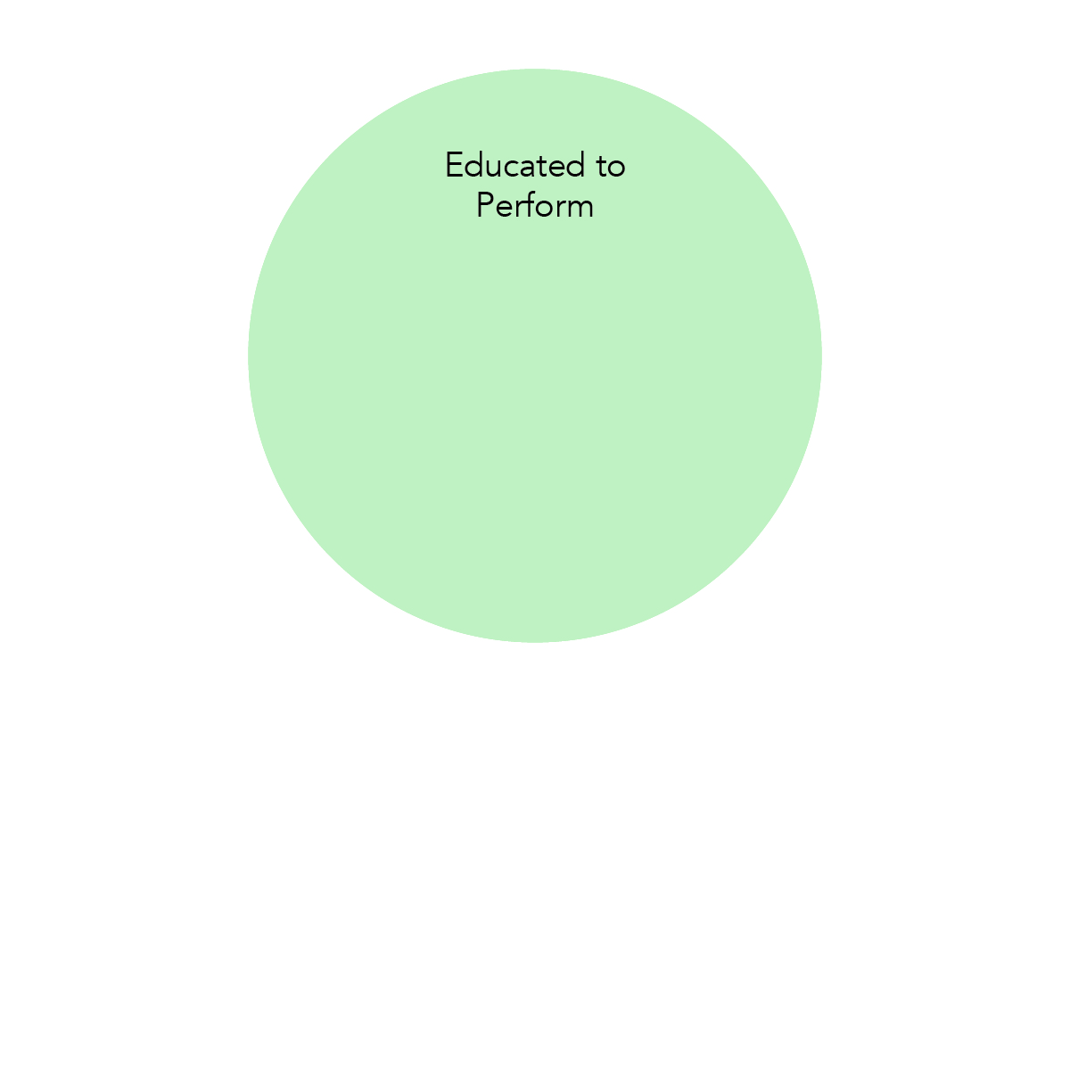

Slide 3
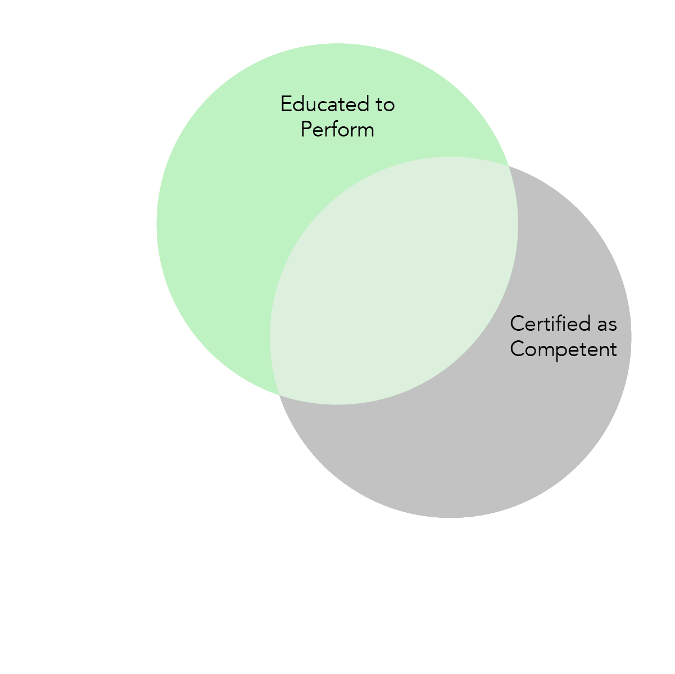

Slide 4
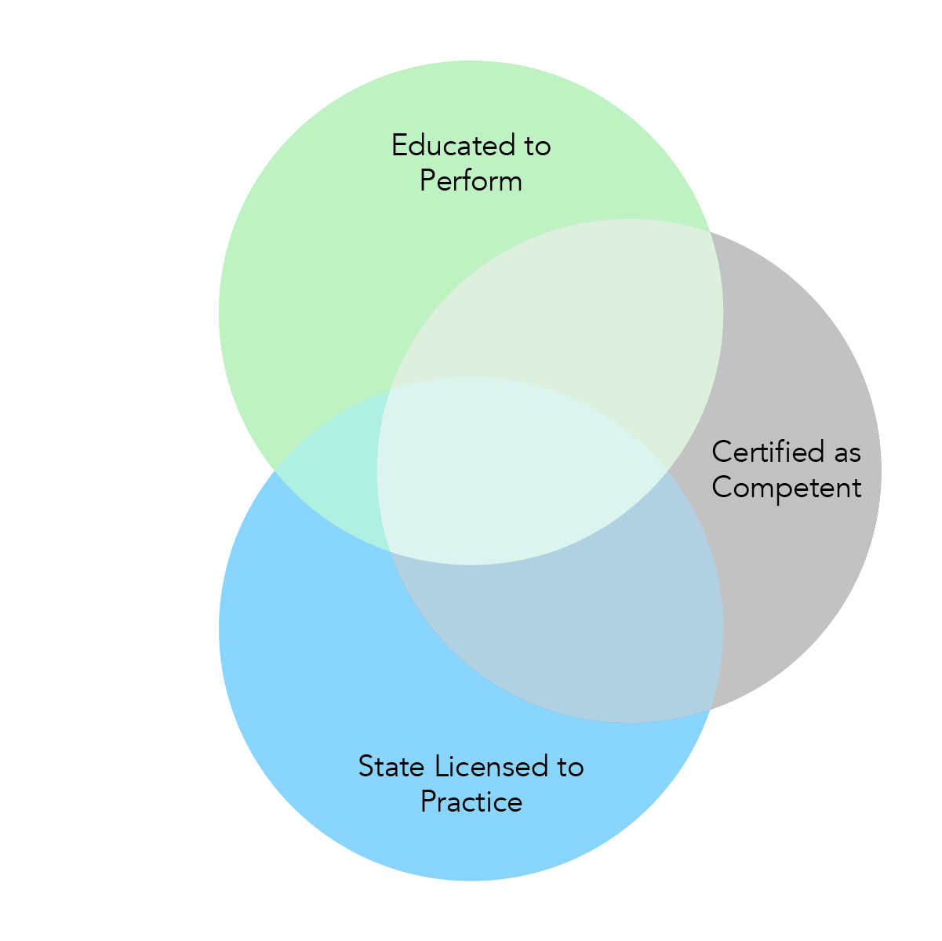

Slide 6
