Slide 1
Using Red Lights and Sirens for Emergency Ambulance Response: How Often Are Potentially Life Saving Interventions Performed?
Jeffrey L. Jarvis, MD, EMT-P. Vaughn Hamilton, MA, EMT-P. Mike Taigman, MA. Lawrence H. Brown, PhD

Slide 2
We are all devoid of conflicts.

Slide 3
Background
EMS response with Red Lights & Sirens (RLS) is associated with increased collisions, injuries, and only marginal time savings.
Goal: Describe the proportion of RLS responses with potentially life saving (PLSI) interventions, by call nature.

Slide 4
Clinical Importance
RLS should be treated like any other medical intervention:
Use only with favorable risk/benefit ratio.
Benefit is unknown

Slide 5
Methods
ESO dataset, 1/1/18 – 12/31/18
Retrospective descriptive analysis
Inclusion: All 911 responses to the scene
Exclusion: Missing call nature, no patient contact
PLSI: “any intervention which might, according to standard clinical guidelines, be considered necessary to reverse a critical condition or rapidly improve hemodynamic stability”.

Slide 6
Results
3,843,123/7,574,879 (51%) 911 calls with documented call nature and patient contact
ALS crew: 3,012,057 (78%)
Urban 79%, Rural 21%
Community 66%, FD 13%, Private, 6%
Paid 79%, Mixed 18%, Volunteer 1%
86% RLS response to scene
13% RLS transport to hospital
7% had any PLSI performed

Slide 7
Potentially Life Saving Interventions
Adenosine | CPR | Intubation | SGA
AED | Defibrillation | Lorazepam | Stroke Alert
Amiodarone | Diazepam | Magills | Suction
Atropine | Dobutamine | Midazolam | Surgical Airway
Back Blows | Dopamine | Naloxone | tPA
Blood | Epinephrine | NIPPV | Tourniquet
BLS Airway | Glucagon | Norepi | Trach Replacement
Calcium | Glucose | OB Delivery | Trauma Alert
STEMI Alert | Heimlich | Pacing
Cardioversion | Hemostatic Agent | Pleural Decompression
Chest Seal | Hydroxycobalamin | Sepsis Alert
Notes:
Total pLSI interventions: 734,531. Proportions on slide are of this total.

Slide 8
Top 10 Potentially Life Saving Interventions
Treatment | Patients | Administrations
Glucose | 69,036 | 79,676
BLS Airway | 62,898 | 87,118
Naloxone | 56,351 | 74,757
Epinephrine | 47,128 | 157,282
Midazolam | 39,480 | 52,547
Intubation | 35,616 | 45,250
CPR | 33,659 | 49,039
NIPPV | 32,740 | 33,595
Suction | 29,256 | 36,017
Trauma Alert | 20,365 | 20,494
Notes:
Total pLSI interventions: 734,531. Proportions on slide are of this total.

Slide 9
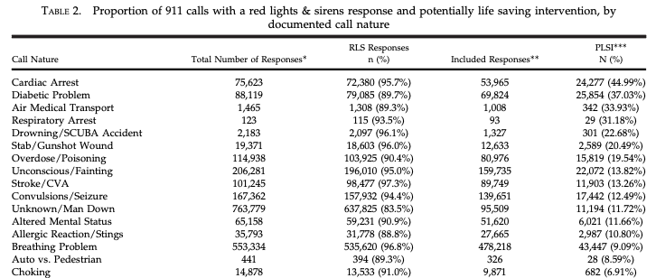

Slide 10
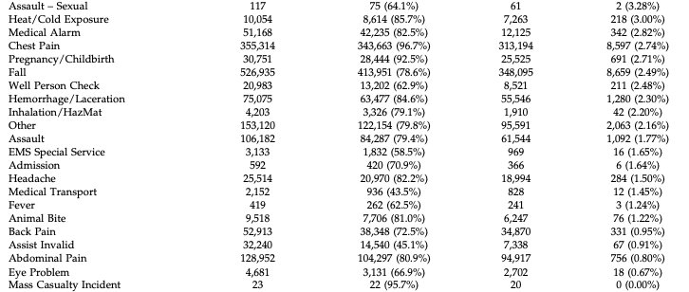

Slide 11
Conclusion
RLS response to scene common (86%)
pLSI at any time rare (7%)
RLS response can likely be safely targeted to call nature.
Threshold Examples:
5% -> 47% RLS Reduction
10% -> 62% RLS Reduction

