Slide 2
Licensed EMS Agencies
Notes:
Louisiana, American Samoa, and Puerto Rico are the missing in this count. The survey question itself recognizes that one EMS agency may operate and be licensed for multiple
services (e.g. “911 Response (Scene) with Transport” and “Air Medical Service”) and appear to be multiple agencies (while, in another state, that agency might have but one license and appear to be one agency). Some states issue licenses for each county, ambulance base or jurisdiction in which an EMS agency
operates. Others may issue one license per agency regardless of how many places that agency bases its equipment and staff and how many jurisdictions it serves.

Slide 3
Licensed Agencies by Type
Notes:
Ambulance, first response, and air medical agencies that are typical EMS 911 responders comprise 18,981 (82%) of the overall agencies documented. Agencies
that provide interfacility/specialty ground transport are 1,988 (9%) of the total. Many 911 responding
ambulances serve in this capacity as well.

Slide 4
Licensed Agencies by Level
Notes:
The Grand Total of 19,520 agencies is consistent with the figure discussed above for agencies
categorized functionally as 911 responders with and without transport, air medical services and
interfacility/ground specialty services (approximately 21,000). A comparison of number of agencies by
function (e.g. 911 response without transport) and level (e.g. emergency medical responder) is tempting
but ultimately not informative.

Slide 5
EMS Vehicles Operating
54,284 Ambulances
Notes:
The Grand Total of 87,781 EMS vehicles in operation whether licensed by a state EMS or not does not include numbers in American Samoa, Iowa, Louisiana, Nebraska, or Puerto Rico. Vehicles in Pennsylvania could not be broken out by type.

Slide 6
Licensed EMS Professionals
Notes:
The most commonly and consistently licensed EMS professionals are emergency medical technicians,
advanced emergency medical technicians (including other levels between emergency medical
technician and paramedic), and paramedics. A total of 855,674 of these professionals were identified.
Emergency medical technicians constitute 63% of these, while 6% are advanced emergency medical
technicians (including other levels between emergency medical technician and paramedic), and 31%
are paramedics. Emergency Medical Responders are licensed in some states and not in others.

Slide 7
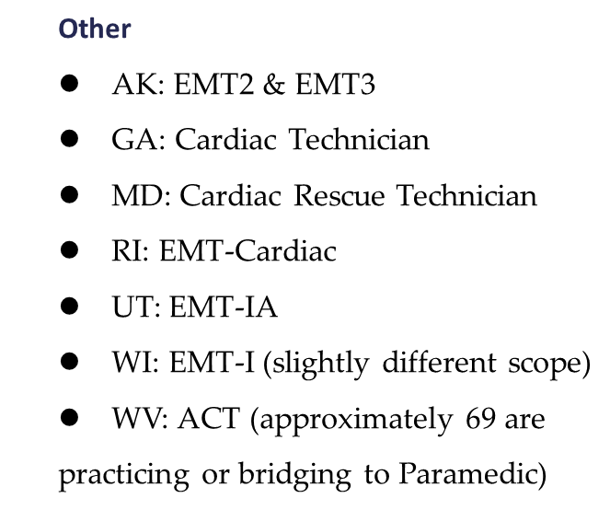
Other License levels in use
Notes:
“Legacy” license levels….dare it be called that!

Slide 8
EMS Professional Age

Slide 9
EMS Professional Race/Gender
Notes:
Only a small number of states were able to identify racial characteristic of the work force, perhaps because of changing licensure demographic information practices.
States with males at 75% or more included Guam, Kentucky, Indiana, Michigan, Mississippi, Arkansas, Georgia, Florida, Arizona, Rhode Island, and Alabama.

Slide 10
States with agencies having communications in Real Time: Chart 43 – Send/Receive telehealth video Chart 44 – Receive patient history on scene Chart 45 – send digital patient/run record to hospital ahead of arrival
Notes:
Chart 43: 1-10% of agencies can do this (12 states or 22%)

Slide 11
EMS responses - 2018

Slide 12
Ems transports - 2018
30,887,679
Total Transports
Notes:
Very undercounted (many large states are unknowns).

Slide 13
How States acquire patient/run data
Notes:
How does the state acquire EMS response and patient care data from the following agency types?
- Submission required through regulation/law (includes effective
enforcement provisions)
- Submission required through regulation/law (with no effective
enforcement provisions)
- Submission not required through regulation/law, but highly encouraged/
enabled to submit
- No requirements, but plan to require submission in the next few years
- No plans to require submission in the near future

Slide 14
State required timeliness of pcr submission

Slide 15
Submission of ems data or analytics for public health or terrorism monitoring

Slide 16
Federal sources of state ems funding

Slide 17
State ems office participation in federal emergency preparedness
Notes:
7 The original question from the survey asked for states to “indicate the level of state EMS office
participation” with the following options: co-located in the same organization; leadership; coordination and
planning; operational role; do not participate. The first four options were grouped into “Participate” for the
purpose of simplification.

Slide 18
State ems office participation in events/drills

