Slide 1
Prehospital Pain Management Evidence-Based Guidelines for the Pharmacologic Management of Acute Pain by Emergency Medical Services
By the National Association of State EMS Officials (NASEMSO), The American College of Emergency Physicians (ACEP®), and the National Association of EMS Physicians (NAEMSP®)
For the National Highway Transportation Safety Administration (NHTSA), Office of EMS
Education Module
© National Association of State EMS Officials (NASEMSO). All rights reserved.
Notes:
One of the most frequent conditions encountered by EMS professionals in the field is pain. While appropriate use of controlled substances is within the standard of care for treating pain in the prehospital setting, the opioid crisis currently facing the nation has fueled an urgent need to develop evidence-based recommendations on the prehospital use of analgesics. For full information see: https://nasemso.org/projects/prehospital-pain-management-ebg/

Slide 2
Disclaimer & Disclosure
This presentation was produced with support from the US Department of Transportation (DOT), National Highway Traffic Safety Administration (NHTSA) Office of Emergency Medical Services, and the US Department of Health and Human Services (DHHS) Maternal and Child Health Bureau’s EMS for Children Program through cooperative agreement number 693JJ92050003.
The contents of this educational module are solely the responsibility of the authors and do not necessarily represent the official views of DOT or DHHS.
© National Association of State EMS Officials (NASEMSO). All rights reserved
Notes:
The project was funded through support from the National Highway Traffic Safety Administration (NHTSA), Office of EMS, and the Health Resources and Services Administration (HRSA), Maternal and Child Health Bureau’s EMS for Children Program, as well as in-kind support from NASEMSO, NAEMSP, and ACEP.

Slide 3
Collaborating Organizations
PRINCIPAL INVESTIGATOR:
National Association of State EMS Officials (NASEMSO)
CO-INVESTIGATORS: American College of Emergency Physicians (ACEP®)
National Association of EMS Physicians (NAEMSP®)
For more information:
https://nasemso.org/projects/prehospital-pain-management-ebg
© National Association of State EMS Officials (NASEMSO). All rights reserved
Notes:
Working collaboratively with the National Association of EMS Physicians (NAEMSP) and the American College of Emergency Physicians (ACEP), NASEMSO led a project to develop evidence-based guidelines (EBGs) for the pharmacologic management of acute pain in the prehospital setting. We have also included non-pharmacologic options for interventions in the educational materials.

Slide 4
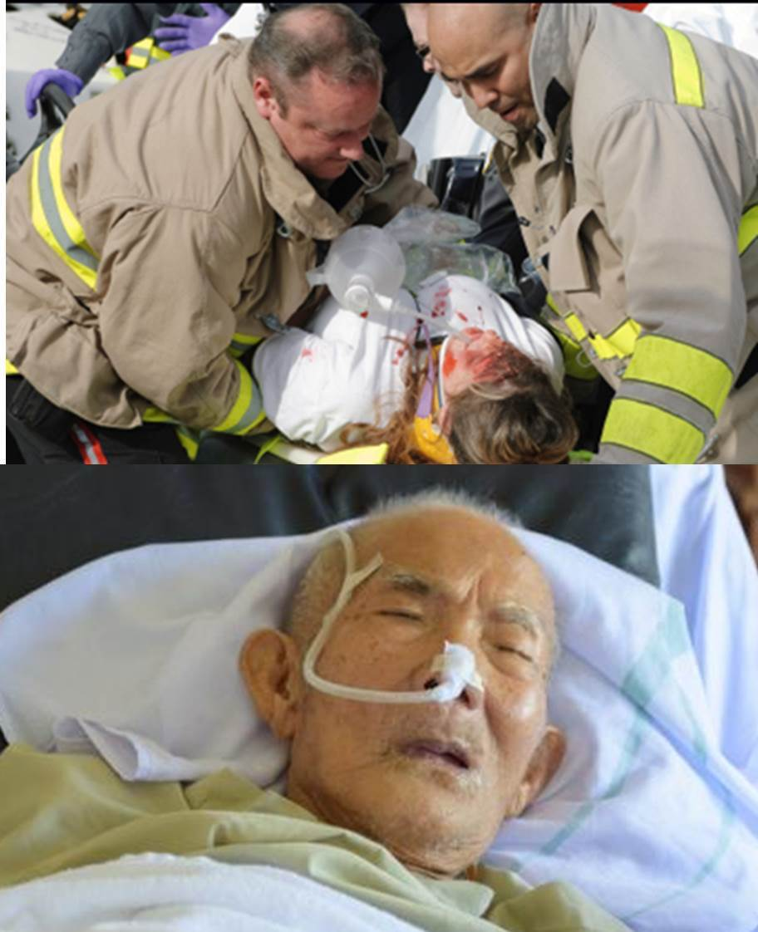
EMS
EMS is charged with providing person-centered evidence-based, and cost effective quality care that improves practice and patient outcomes
It can take years to integrate evidence into practice – and when it comes to pain mgt in our current environment, we don’t have years to figure it out!
https://specialty.mims.com/
© National Association of State EMS Officials (NASEMSO). All rights reserved
Notes:
Compelling needs based on multiple changes in the healthcare environment, patient populations, and transition to value-based care are demanding rapid adaptation to evidence-based practice.
We seek the collective cooperation of EMS leaders and educators throughout the country to review this evidence and move the “needle” forward in a new and improved multimodal approach to pain management by EMS personnel.

Slide 5
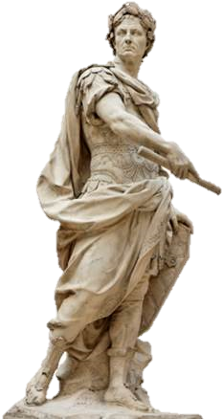
“It is easier to find men who will volunteer to die, than to find those who are willing to endure pain with patience.”
Julius Caesar
How can EMS best assess and manage pain to reduce physical, psychological and emotional suffering?
© National Association of State EMS Officials (NASEMSO). All rights reserved
Notes:
What is pain? Pain is a subjective and complex unpleasant sensory and emotional experience, often associated with actual or potential tissue injury and includes multiple dimensions. It is an early warning signal that something is wrong! The desire for pain relief often supersedes a patient's desire to identify and resolve the cause of the pain. Physical pain may not present as a primary disease but as a symptom of a disease or injury. Pain can exist even when no physical cause can be found.
Ask participants to think of a time that they were in real pain, perhaps for a significant length of time. Would they agree with Caesar’s statement?
While pain is a definite part of the EMS assessment, treatment is often placed as a lower priority. We have an opportunity to better address the experience of pain, its causes, presentations, and importantly, multimodal approaches to appropriate treatment across the spectrum of person-centered EMS care.

Slide 6
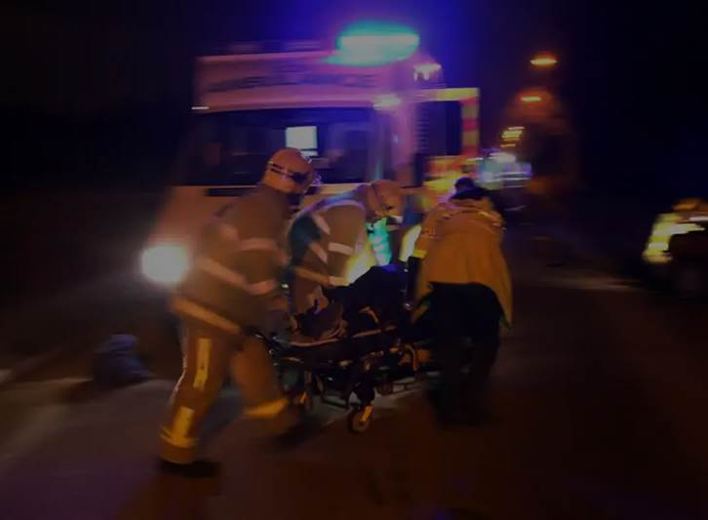
Follow the
EVIDENCE
Analyze its merits
Adapt practice as needed
Photograph: Rex Features
© National Association of State EMS Officials (NASEMSO). All rights reserved
Notes:
…and that is what the TEP has done and proposes to bring forward to the EMS community!

Slide 7
Introductory remarks
George Lindbeck, MD
State EMS and Trauma Medical Director
Virginia Department of Health
Principal Investigator
NASEMSO
© National Association of State EMS Officials (NASEMSO). All rights reserved
Notes:
The principal investigator was George Lindbeck, MD from NASEMSO. Dr. Lindbeck has 30 years of experience in academic and community emergency medicine and service in local, regional, state, and national EMS organizations. In addition to his professional duties in Virginia, he serves as Chair of the NASEMSO Medical Directors Council.
Co-investigators were Sabina Braithwaite, MD, representing ACEP, and Manish Shah, MD, of NAEMSP. Together they led a multi-disciplinary technical expert panel (TEP) comprised of an EMS clinician and EMS educator, as well as others with expertise in emergency medicine, pediatrics, pain mgt, pharmacology, trauma care, guideline development methodology, patient advocacy, and EMS data.

Slide 8
Overall project flow diagram
*EBG Technical Expert Panel consisted of pain management experts, EMS physicians, EMS clinicians, researchers, and educators, pediatric emergency medicine physicians, a pharmacologist, a patient advocate, and an evidence-based guideline methodologist
© National Association of State EMS Officials (NASEMSO). All rights reserved
Notes:
AHRQ: Agency for Healthcare Research and Quality
NASEMSO: National Association of State EMS Officials
ACEP: American College of Emergency Physicians
NAEMSP: National Association of EMS Physicians
EBG: Evidence-based guidelines
TEP: Technical Expert Panel
PICO: Patient/population-intervention-comparison-outcome
GRADE: Grading of Recommendations, Assessment, Development, and Evaluation

Slide 9
Project goals
Develop a set of EBGs for EMS pain mgt building on the AHRQ findings
Develop performance measures for pain management and patient care guidelines
Develop educational materials for EMS clinicians to roll out the EBG and patient care guidelines
Notes:
This project produced the following deliverables:
Two manuscripts published in a peer-reviewed scientific journal (PEC), describing the methodology used to develop evidence-based guidelines. The articles are available at EBGs for Pain Management: Recommendations and EBGs for Pain Management: Literature and Methods
Model EMS treatment protocol on the pharmacologic management of pain incorporating the evidence-based guidelines, available at Model Protocol;
Performance measures for evaluating adherence to the evidence-based guideline, available at Pediatric IN Fentanyl Performance Measure;
Educational materials for training EMS professionals on the pain management evidence-based guidelines, including a Slide Presentation-pptx (Slide Presentation PDF) , Lesson Plan, and Drug Profiles.

Slide 10
What is evidence-based practice?
Clinical Expertise
Evidence Based Practice
Best Research Evidence
Patient values & preferences
https://guides.library.uq.edu.au/how-to-find/evidence-based-practice

Slide 11
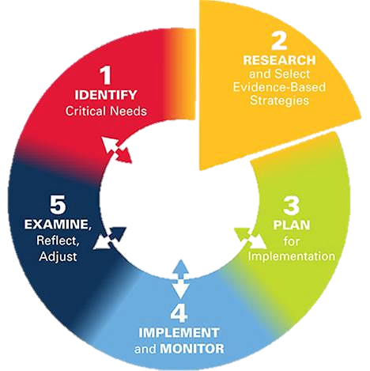
Agency for Healthcare Research and Quality (AHRQ) did a systematic review of comparative effectiveness of analgesics used by EMS
http://education.ohio.gov/Topics/District-and-School-Continuous-Improvement
© National Association of State EMS Officials (NASEMSO). All rights reserved

Slide 12
The TEP developed 9 PICO* questions based on AHRQ review + 1 re: peds analgesia via fentanyl IN
*Patient/population-intervention-comparison-outcome
Elements of a systematic review
Frame questions
Involve stakeholders
Define what is to be examined and how
Explicit questions
Commitment to update
Rigorous review methods
Transparent
Repeatable
Systematic evaluation of evidence
To stakeholders and decision-makers using appropriate formats for different end users
Active dissemination of results
www.forestsnews.cifor.org/19403/
© National Association of State EMS Officials (NASEMSO). All rights reserved

Slide 13
GRADE methodology
Grading of Recommendations, Assessment, Development, and Evaluation
Detailed methodology, summary findings, evidence-to-decision tables presented in companion paper
Strength of recommendation on a continuum
Strong against Conditional Strong for
Notes:
For an overview of GRADE methodology, see: https://nasemso.org/wp-content/uploads/Overview-of-GRADE-Methodology-for-Developing-Evidence-Based-Guidelines.pdf

Slide 14
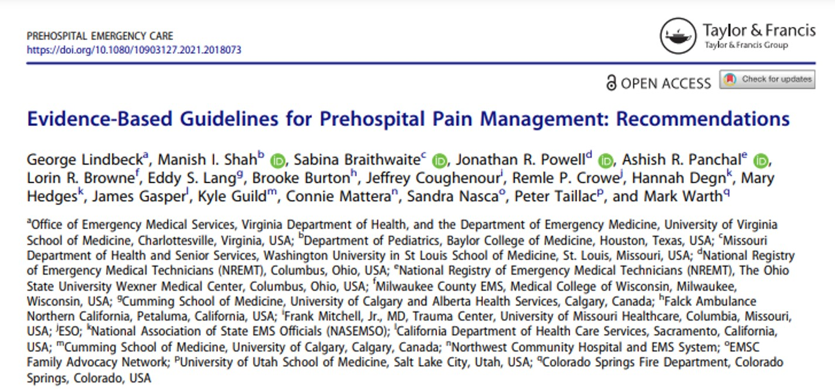
Notes:
The articles are available at EBGs for Pain Management: Recommendations and EBGs for Pain Management: Literature and Methods
We strongly suggest that these are available to the educators and participants when local roll-out of these guidelines or this presentation occurs.

Slide 15
Education offering objectives
Upon completion, each participant will do the following with a level of proficiency that meets the standards for their scope of practice:
Identify the major recommendations of the EMS Pain Mgt Guidelines and explain their rationales..
Safely implement EBG for pain management within their local protocols.
Defend the need for person-centered EMS pain management based on quality evidence.
© National Association of State EMS Officials (NASEMSO). All rights reserved.
Notes:
Education on the project outcomes and deliverables is designed to meet local preferences and requirements. Ideally, participants will have access to the webinar recording, slide-deck handout, drug profiles, and local policies, drug administration procedures, and protocols. It could be presented as a virtual class or face-to-face with local EMS Medical Director and faculty enhancements. Educators have access to the slides + notes, this faculty storyboard and a sample lesson plan. Supporting information and materials are all available on the NASEMSO website https://nasemso.org/projects/prehospital-pain-management-ebg/

Slide 16
PICO Questions & Recommendations
Each question will be presented individually with the strength of the evidence, guideline recommendation, rationales, and caveats
Ashish R. Panchal, MD, PhD
NREMT
The Ohio State University Wexner Medical Center
Notes:
Dr. Panchal is the Director of Research for the National Registry of Emergency Medical Technicians. He oversees the NREMT’s research and serves as mentor to the NREMT’s research fellows. Dr. Panchal also works as an Associate Professor of Emergency Medicine at The Ohio State University Wexner Medical Center. He is the pre-hospital medical director for the Delaware County EMS and the Newark Fire Department.

Slide 17
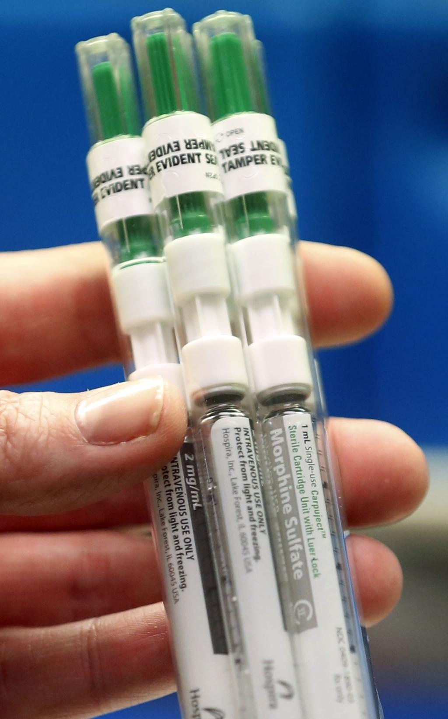
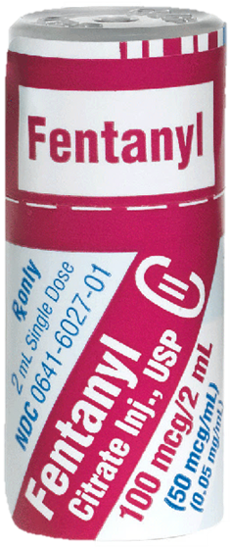
PICO #1: Should INTRANASAL FENTANYL vs. IV/IM OPIOIDs be used for acute onset of moderate to severe pain in children in the prehospital setting?
www.aboutkidshealth.ca/article?contentid=3892&language=english#

Slide 18
PICO #1 - Strong Recommendation (Low certainty of evidence)
We recommend in favor of IN fentanyl over IM or IV opioids in the treatment of moderate to severe pain in pediatric patients prior to vascular access or without (or no indications for) IV access
Conditional recommendation: Either IN fentanyl or IV opioids once IV access established
Pain mgt in peds challenging, priority of care
Advantages: Effectiveness; ease of use
© National Association of State EMS Officials (NASEMSO). All rights reserved.
Notes:
Evidence did not suggest a difference in pain severity scores at 5, 10, 15, 20, 25, and 30 minutes after IN administration vs. IM or IV opioids; no clinically significant differences in undesirable effects between the two options. No significant differences in therapeutic effects or adverse effects of fentanyl given IN when compared to IV or IM routes.

Slide 19
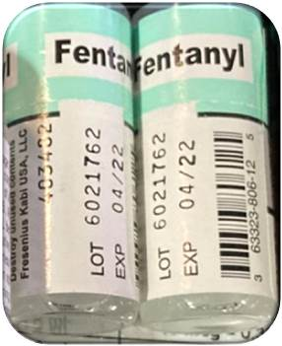
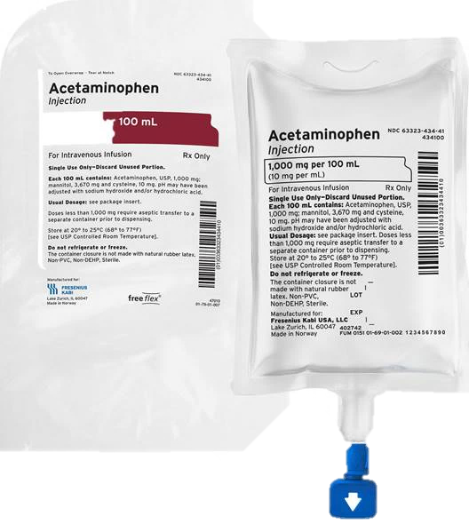
PICO #2: Should IV ACETAMINOPHEN vs. IV OPIOIDs be used to treat moderate to severe pain in the prehospital setting?
vs..

Slide 20
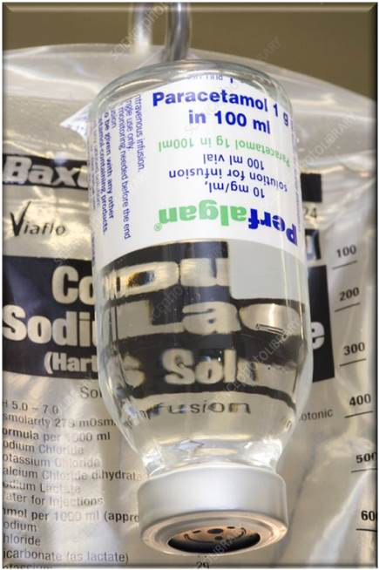
PICO #2 - Conditional Recommendation (Low certainty of evidence)
We suggest in favor of IV acetaminophen over IV opioids alone if APAP is available, affordable, & easy to give
Rationale: Equivalent pain control, better tolerability
Possible disadvantages: Cost; given by infusion; EMS often prefers IVP or rapid delivery routes
Is this available where you work now?
https://orthoserviceline.com/
Notes:
All studies on use of IV APAP done in EDs outside of US

Slide 21
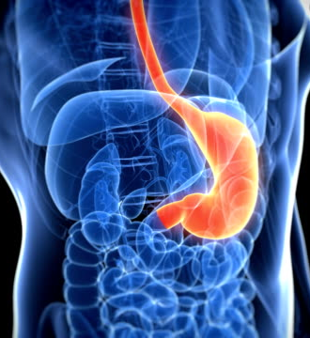
Considerations re: nausea
APAP may produce less dizziness, nausea and/or vomiting than opioids
May avoid concurrent use of antiemetic
Etiologies of nausea:
Pain; anxiety; GI disorders, infection, medications & toxins, CNS, endocrine & metabolic
Opioids: direct stimulation medulla chemoreceptors
Motion sickness in EMS vehicle (Weichenthal)
https://www.gettyimages.com/
Notes:
An excellent reference is available from UpToDate® on the differential diagnosis of nausea and vomiting (2021).
www.uptodate.com/contents/image/print?imageKey=GAST%2F78422&topicKey=GAST%2F2537&source=see_link&search=

Slide 22
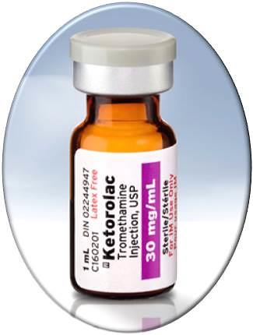
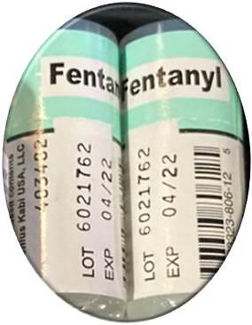
PICO #3: Should IV NSAIDs vs. IV OPIOIDs be used for treatment of moderate to severe pain in the prehospital setting?

Slide 23
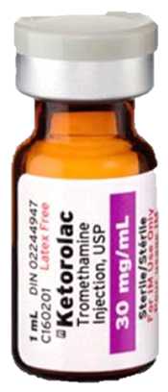
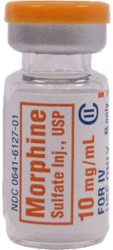
PICO #3 – Conditional Recommendation
(Moderate certainty of evidence)
We suggest either IV NSAIDS or IV Opioids for the mgt of moderate to severe pain
Insufficient evidence to make a recommendation re: pain severity at 15 minutes, partial or full relief of pain, or time to analgesic effect
Concerns:
Sub-therapeutic dose of ketorolac in limited data
© National Association of State EMS Officials (NASEMSO). All rights reserved.
Notes:
Evidence did not demonstrate any clinical significance in pain severity at 30 or 60 minutes.

Slide 24
PICO #3 - Considerations
Cost differential: ketorolac more expensive
Adverse events may be more common with opioid (morphine) (Rainer)
IV NSAIDs attractive if patient is opioid tolerant or dependent, claims opioid allergy or intolerance, or prefers drug with lower risk profile
Which do you use now?
https://www.ezgolearning.com/
© National Association of State EMS Officials (NASEMSO). All rights reserved.

Slide 25
PICO #4: Should IV ACETAMINOPHEN (APAP) vs. IV NSAIDs be used to treat moderate to severe pain in the prehospital setting?
www.jems.com/patient-care/a-guide-to-prehospital-pain-management/

Slide 26
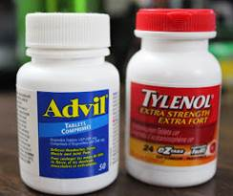
PICO #4 - Conditional Recommendation (Low certainty of evidence)
We suggest in favor of IV NSAIDS over IV APAP for the initial mgt of moderate to severe pain in the prehospital setting
We also recommend in favor of either PO NSAIDs or PO ACETAMINOPHEN for the Initial mgt of pain in the prehospital setting
https://www.crspecialists.com/
© National Association of State EMS Officials (NASEMSO). All rights reserved.

Slide 27
PICO #4 - Rationale
IV route: Little difference in pain severity at 30 or 60 min or in partial or complete pain relief
Adverse events: Comparable
Cost & feasibility: Favors IV NSAIDs
Consider oral, non-opioid analgesics
All evidence: Non-graded; ED based
https://smartegies.com/
© National Association of State EMS Officials (NASEMSO). All rights reserved.
Notes:
EMS is generally accustomed to using parenteral analgesics for rapid onset of action and ease of delivery. This is the only question that explored a PO delivery route.

Slide 28
PICO #4 – Caveats
All are candidates for pain mgt & comfort measures regardless of transport interval
Do not assume fast analgesic Rx at ED - may have significant delays (Woolner, Patrick)
Any EMS analgesics (including PO) may markedly improve pain relief well into ED stay
https://www.bostonglobe.com/

Slide 29
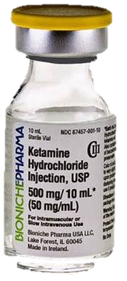
PICO #5: Should IV KETAMINE vs. IV NSAIDs be used to treat moderate to severe pain in the prehospital setting?

Slide 30
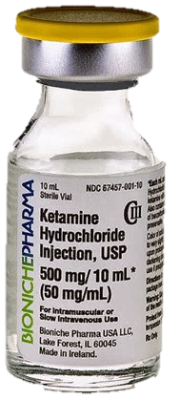
PICO #5 - Conditional Recommendation (Very low certainty of evidence)
We suggest either IV ketamine or IV NSAIDs for the initial mgt of moderate to severe pain in the prehospital setting
Single study found significant pain relief at 30 min after ketorolac compared to ketamine, but no significant differences at 15 or 60 min, time to analgesic effect, pain relief, or pain memory
SE higher with ketamine – not clinically significant
© National Association of State EMS Officials (NASEMSO). All rights reserved.
Notes:
SE with ketamine: (dizziness, increased BP & HR)

Slide 31
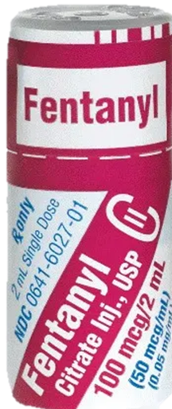
PICO #6: Should IV KETAMINE vs. IV OPIOIDs be used to treat moderate to severe pain in the prehospital setting?

Slide 32
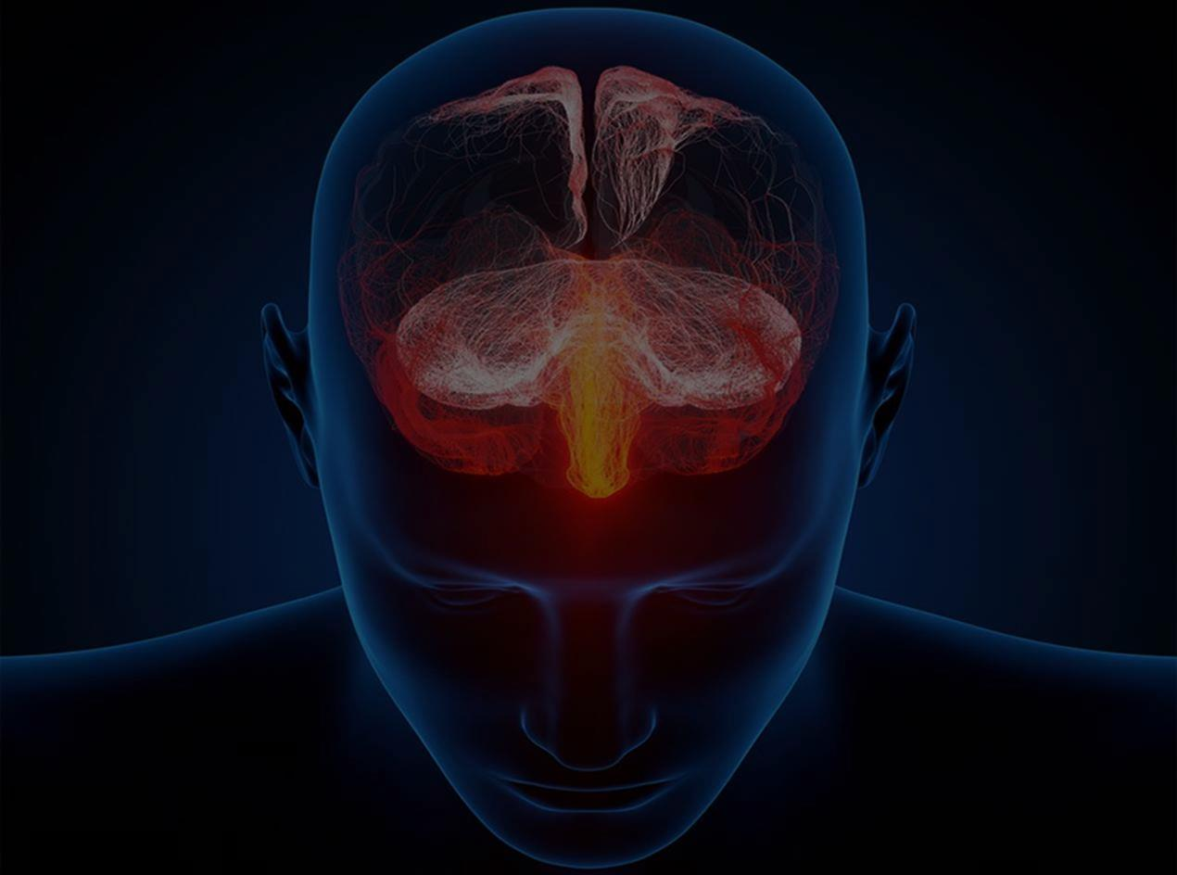
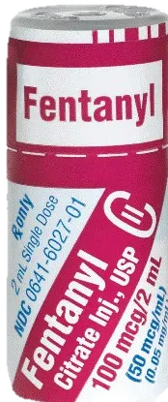
Pico #6 - conditional recommendation (Very low certainty of evidence)
We suggest either IV ketamine or IV opioids for the initial mgt of moderate to severe pain
No clinically significant difference in pain at 15, 30, or 60 min, in partial or complete pain relief, or time to analgesia effect
Small sample size; difficult for pts to quantify
/www.thepainpt.com/
© National Association of State EMS Officials (NASEMSO). All rights reserved.

Slide 33
Pico #6 - Rationale
Ketamine provides inconsistent but potentially rapid onset of pain relief and currently has a wide range of dosing strategies (IVP, IVPB, IM, IN)
Number of pts experienced mild-to-moderate side effects (dizziness, dysphoria, confusion) (Ghate)
Do you use ketamine?
Notes:
Series of 500 patients given low dose ketamine (0.1-0.3 mg/kg) in ED found 3.5% experienced a psychomimetic or dysphoric reaction (Ahern –see published paper). Opioid administration was suggested to increase respiratory depression, but not clinically significant.
As an analgesic, ketamine may provide equal or better pain relief when compared with other available out-of-hospital medications and is associated with a lower incidence of nausea and vomiting (Fernandez et al, 2021).

Slide 34
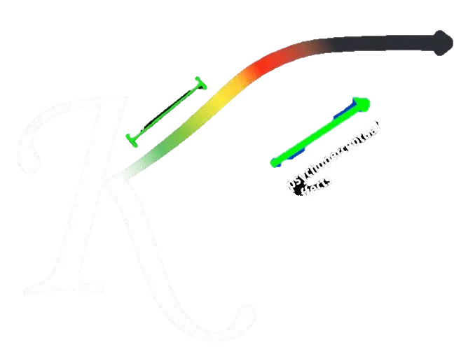
Ketamine brain continuum
Dosing important!
Partially dissociated
Dissociated
Recreational
Analgesia
ef
https://www.clinicalpainadvisor.com/
© National Association of State EMS Officials (NASEMSO). All rights reserved.
Notes:
Ketamine has become increasingly used by EMS for indications ranging from pain to sedation due to its potent effects, wide therapeutic window, and favorable risk profile (Fernandez et al, 2021). It produces a unique combination of hypnotic, analgesic, and amnestic effects based on dose.

Slide 35
PICO #6 - Conclusions
IV opioids used more commonly now, but both drugs likely acceptable to stakeholders
Ketamine: Viable alternative for pain if patient is opioid tolerant or dependent, claims opioid allergy or intolerance, or has experienced adverse events with opioids
Non-opioid option may increase health equity, but not addressed in this evidence base

Slide 36
PICO Questions & Recommendations
Continuing the discussion…
Jonathan Powell, MPA, NRP
NREMT Research Fellow

Slide 37
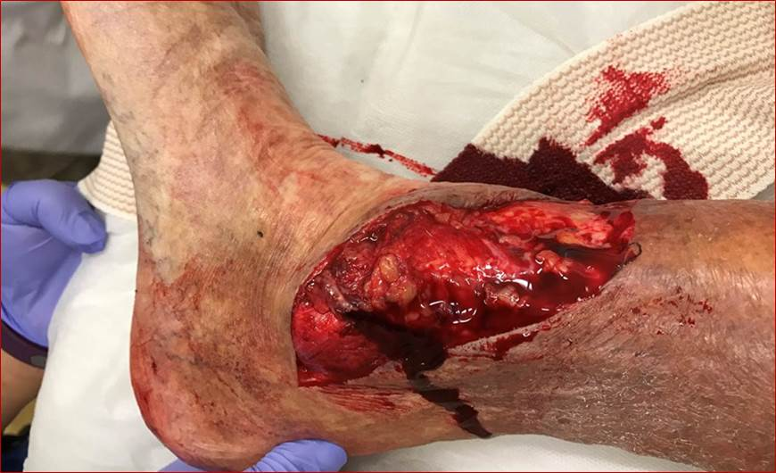
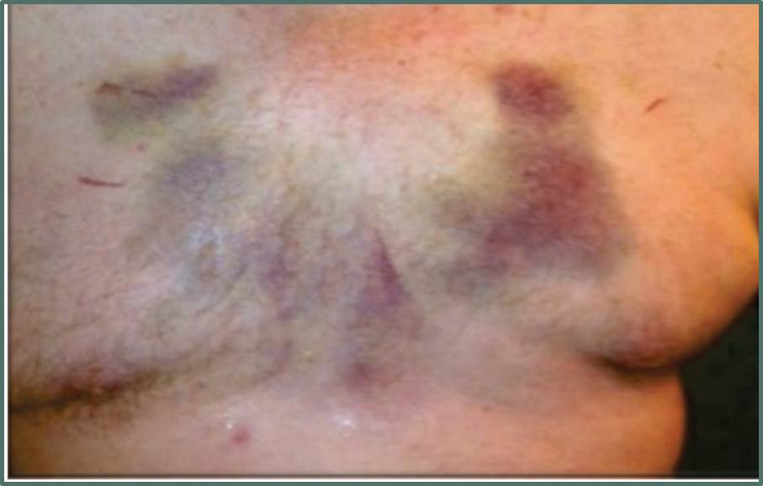
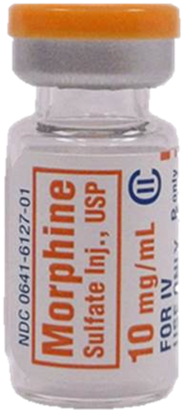
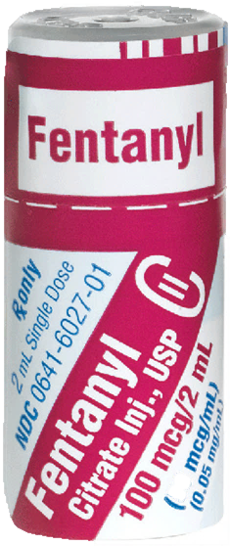
PICO #7: Should IV morphine vs. IV fentanyl be used to treat moderate to severe pain in the EMS setting?
© National Association of State EMS Officials (NASEMSO). All rights reserved.

Slide 38
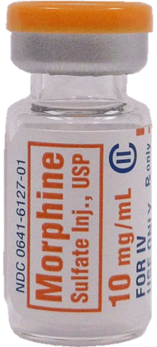
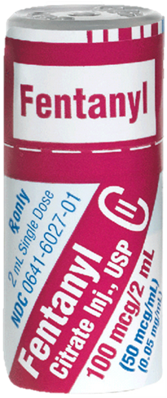
PICO #7 - Conditional recommendation (low certainty of evidence)
If opioids are selected for pain mgt., we suggest either IV morphine or IV fentanyl for the treatment of moderate to severe pain in the prehospital setting
No significant differences in pain scores, resolution of pain, or time to analgesia
Morphine: Associated with higher rates of nausea
Fentanyl: More route options (IN)
Conflicting results in EMS vs. hospital-based trials
© National Association of State EMS Officials (NASEMSO). All rights reserved.
Notes:
IN option for fentanyl may make it attractive, particularly in pediatric patients.

Slide 39
PICO #7 – Rationale
Opiates have been the cornerstone of pain management for centuries
Natural + Synthetic Agents
Bind to opioid receptors in and outside of CNS
“Mu-1” produce clinical analgesia
“Mu-2” produce respiratory depression, euphoria, physical dependence, and constipation
Theothersong.com
Notes:
Natural opioids (morphine) produce histamine that can make the patient itch and cause vasodilation.

Slide 40
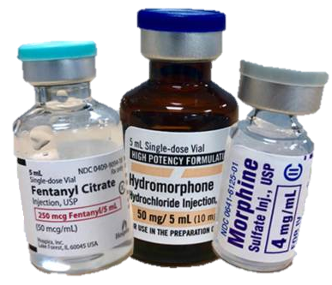
PICO #7 – Rationale cont.
Other receptors: delta, sigma, kappa, and epsilon
Kappa produces analgesia, sedation and miosis
Select an opioid based on pain severity, route options, previous responses to opioids, SEs, how drug may interact with a patient’s disease state(s) & local protocols
Which do you prefer?
https://www.marketplace.org/

Slide 41
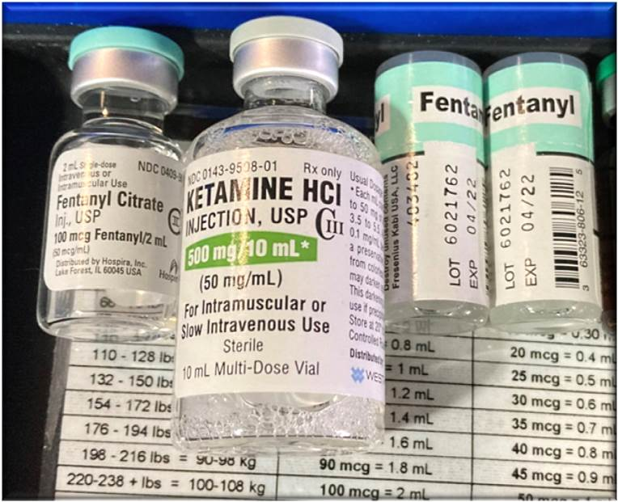
PICO #8: Should a combination of weight-based IV OPIOID + KETAMINE vs. weight-based IV OPIOID alone be used to Rx moderate-severe pain in the prehospital setting?
© National Association of State EMS Officials (NASEMSO). All rights reserved.

Slide 42
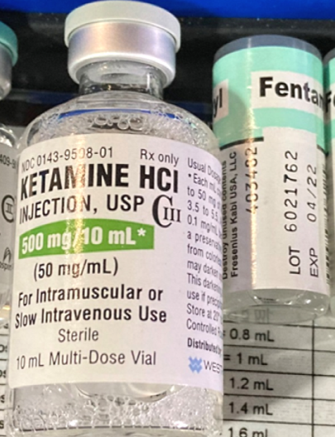
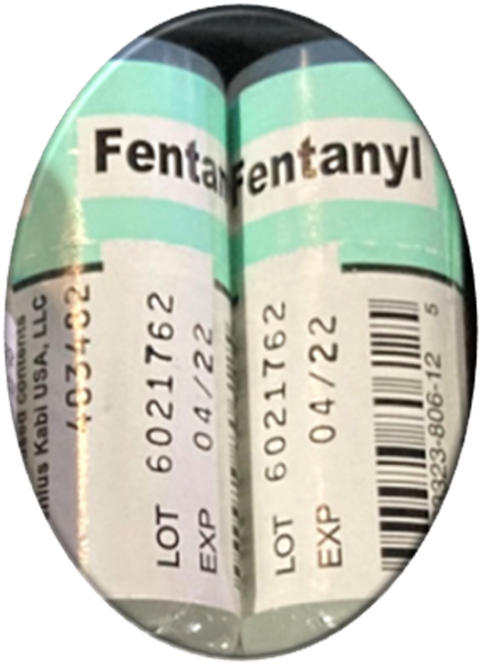
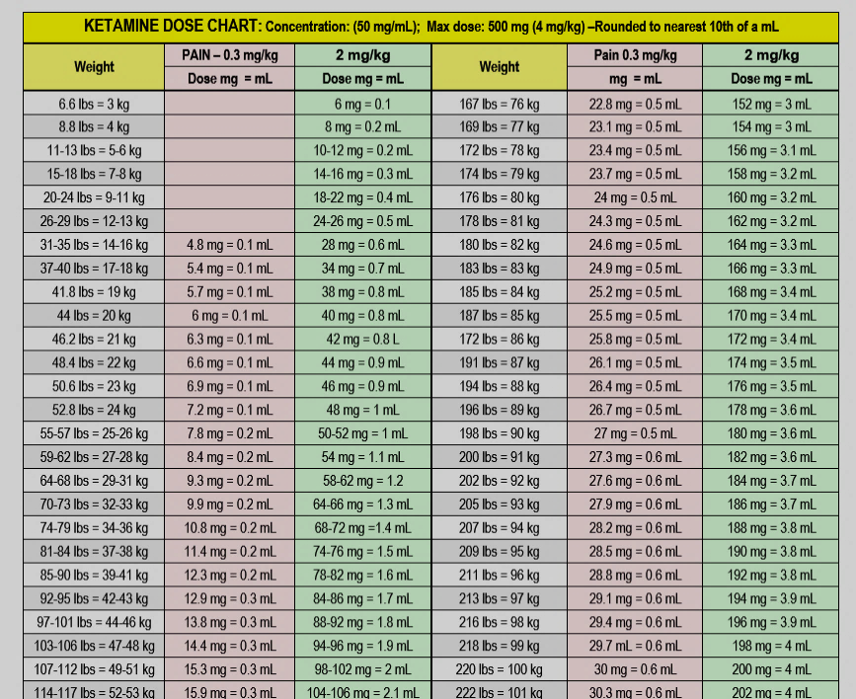
Pico #8 - conditional recommendation (very low certainty of evidence)
We suggest AGAINST the combination of weight-based IV opioid + wt-based IV ketamine vs. weight-based IV opioid alone
Rationale: Lack of clinical improvement in pain control, slight increase in undesirable SE, and desire to avoid complexity in administration
© National Association of State EMS Officials (NASEMSO). All rights reserved.
Notes:
Dizziness more common in combination therapy group; but insufficient evidence related to other reported adverse events.
No increase in respiratory depression in combination therapy group.
Possibly, multiple drugs allow for lower and safer doses of the analgesics (Helander).
Monotherapy avoids complexity (and possibly drug errors) in preparation and delivery.
Weight-based dosing regimens are an identified challenge, especially when dealing with medications that have two different doses for two different indications and in pediatric patients.

Slide 43
PICO #9: Should a combination of IV OPIOID + IV KETAMINE vs. IV KETAMINE alone be used to treat moderate to severe pain in the prehospital setting?

Slide 44
Pico #9 - NO recommendation (very low certainty of evidence)
NO recommendation made at this time on the combination of IV KETAMINE + IV OPIOID vs. IV KETAMINE alone due to significant uncertainty of the evidence and incomplete information concerning the comparison
Need more
https://www.youtube.com/watch?v=56rDexucUDU
© National Association of State EMS Officials (NASEMSO). All rights reserved.
Notes:
No significant differences in pain control at 15, 30, or 60 minutes; in partial or complete pain relief, or time to analgesic effect between the two medications. Dizziness more common in combination therapy group; but insufficient evidence related to other reported adverse events. No increase in respiratory depression in combination therapy group.
Possibly, multiple drugs allow for lower and safer doses of the analgesics (Helander).
Monotherapy avoids complexity (and possibly drug errors) in preparation and delivery.
Weight-based dosing regimens are an identified challenge, especially when dealing with medications that have two different doses for two different indications and in pediatric patients.

Slide 45
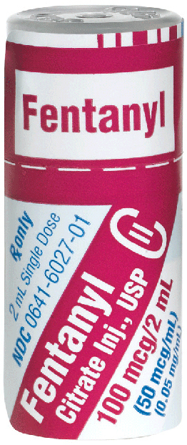
PICO #10: Should NITROUS OXIDE vs. IV OPIOIDs be used to treat moderate to severe pain in the prehospital setting?

Slide 46
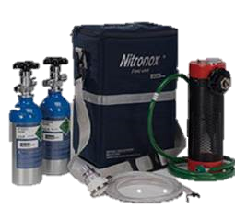
PICO #10: NO RECOMMENDATION
(Very low certainty of evidence)
NO recommendation made on the comparison between nitrous oxide vs. IV opioids for the initial management of moderate to severe pain in the prehospital setting
Potential cons: Cost, gas replacement; needs responsive patient who can follow instructions; contraindicated in pneumothorax/bowel obstructions
www.porterinstrument.com
Notes:
N₂O used by EMS for decades – but little published on it, so could not make a recommendation

Slide 47
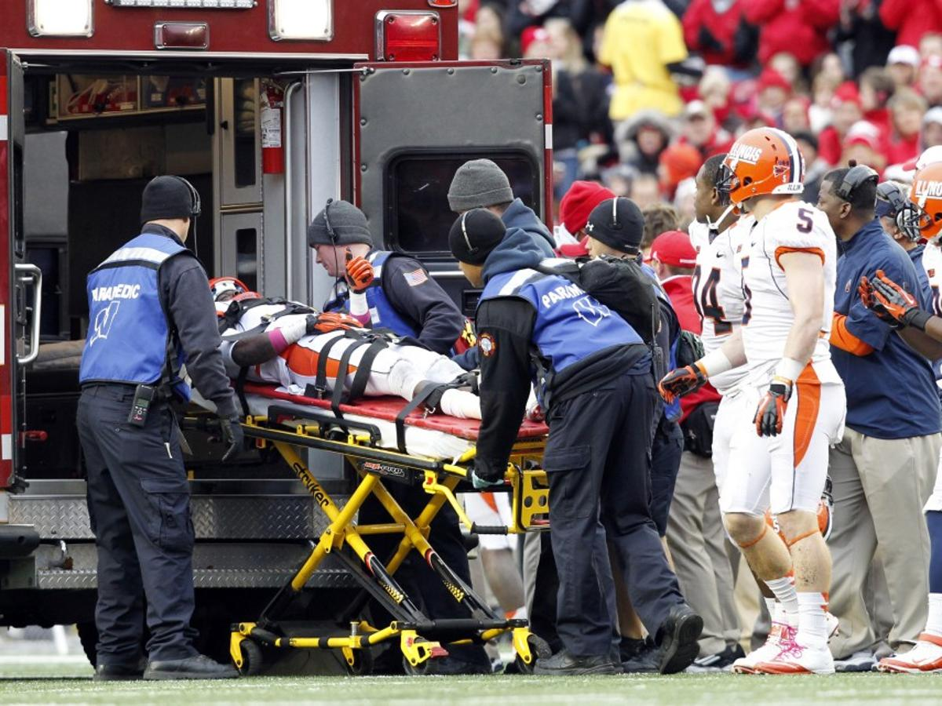
DISCUSSION
Pain management is a core competency for EMS practitioners
https://madison.com/sports

Slide 48
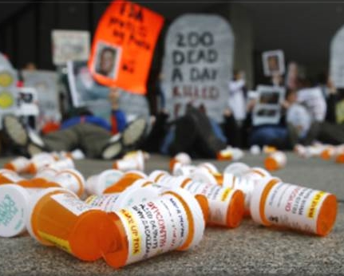
Why is this important?
Pain is a frequent complaint of EMS patients
Historical reliance on IV opioids
Growing opioid epidemic and expanding medical options opened door to exploring evidence-based guidelines (EBGs) with choices identified
https://thesouthern.com/
Notes:
America’s opioid epidemic continues unabated. Preliminary federal data released in April 2021 showed that 87,000 Americans died of drug overdoses in the 12 months through August 2020, with opioid-related fatalities being a primary driver in those numbers. That’s more than any 12-month period since the opioid epidemic began, according to the Centers for Disease Control and Prevention (CDC).
Opioids accounted for around 75% of all overdose deaths during the early months of the pandemic; about 80% of those included synthetic opioids like fentanyl.
The final 2020 overdose death total in the U.S. could exceed 90,000, compared with 70,630 in 2019. That would be not only the highest annual number on record, but the largest single-year percentage increase in the last 20 years.
AHA expert recommendations:
Isolation and social distancing are risk factors for opioid abuse.
Areas to improve in the fight against opioids include awareness, harm reduction and decreasing stigma.
Comprehensive screening can help keep a pulse on substance use in your community.
Pay attention to pain management protocols and support alternatives to opioids programs.

Slide 49
Current EMS Data
Challenges persist in providing adequate analgesia in the field
Pain frequently undertreated
Disparities accentuated based on patient demographics
Remle Crowe, Ph.D., NREMT
ESO Solutions
Notes:
Dr. Crowe is an expert in quality improvement and research. As a research scientist at ESO and faculty member of the NAEMSP Quality and Safety Course, Dr. Crowe routinely uses data to improve community health and safety.

Slide 50
What are the barriers to effective pain management by EMS?
www.frontier-pitts.fr
© National Association of State EMS Officials (NASEMSO). All rights reserved.
Notes:
- Clinicians’ attitudes, beliefs, and behaviors; bias may contribute to under-treatment of pain
- Do not accept pt’s self-report as reliable; disparity between clinician and patient rating; suspicion of drug-seeking behavior
Insufficient or improper assessment and/or failure to recognize that patient is in moderate to severe pain due to many reasons: denied access to completing a physical exam due to sincerely held religious or cultural traditions
Communication challenges; language barriers; cognitive abilities
Coexisting physical/psychological illness; reluctance to report pain (stoicism, fear)
- Traditional reliance on opioids that pt dissents to receiving due to substance use disorders or addiction concerns
- Other emergent treatment priorities at the moment delay pain interventions
-Difficult or unobtainable vascular access
-Need for short scene time; or short transport time
-Concerns regarding accurate medication dosing (peds, elderly, obese); side effects; and/or inadequate monitoring ability.
-May be compounded by drug shortages with rapid formulary substitutions or concentration changes in known medications.
-Denial of order from online medical control or anticipation of criticism from receiving hospital

Slide 51
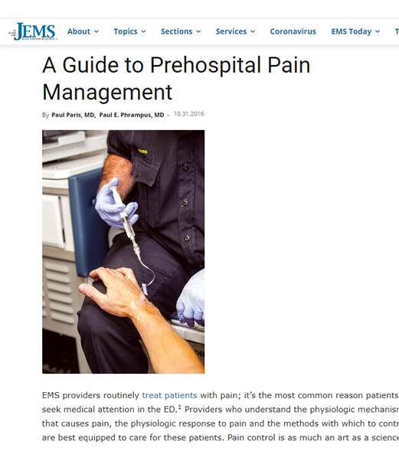
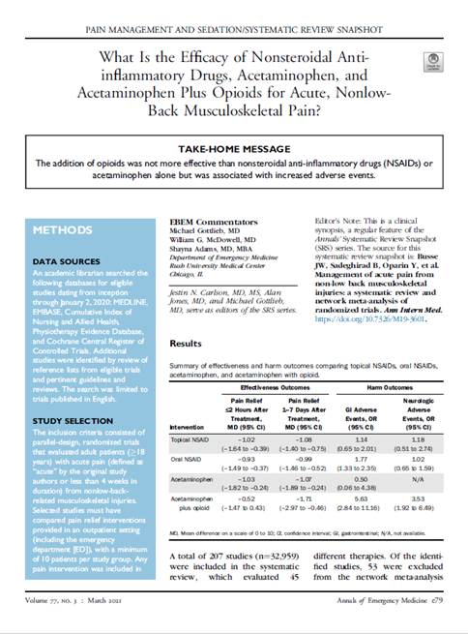
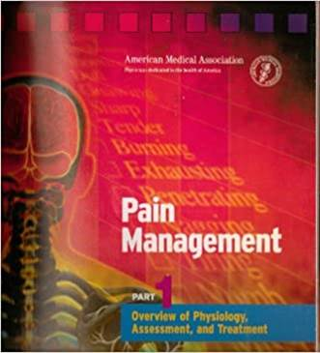
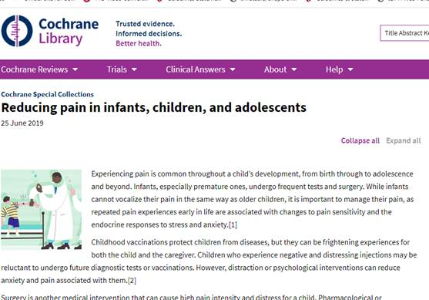
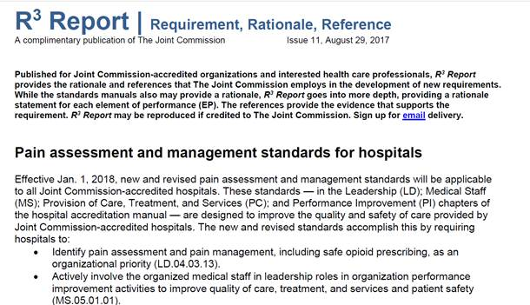
We don’t always follow the EVIDENCE!
© National Association of State EMS Officials (NASEMSO). All rights reserved.

Slide 52
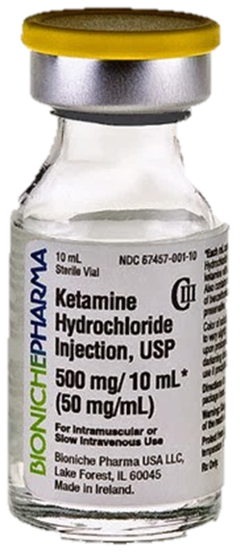
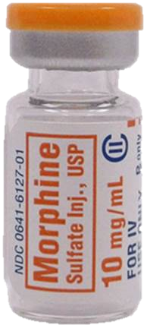
What meds were used for EMS pain mgt by Eagle Systems? (2/15)
Fentanyl (60%)
Morphine (43%)
Ketamine (16%)
Ketorolac (16%)
Nitrous Oxide (6%)
Dilaudid (6%)
IV Acetaminophen (1 system)
© National Association of State EMS Officials (NASEMSO). All rights reserved.
Notes:
Used for historical reference only.

Slide 53
2019 NEMSIS public use research database
N total: 26,501,968 records for 911 responses
N Pain subset (initial pain score documented at ≥6): 3,206,755 pts
Received prehospital analgesics: 428,562 (13%)
Drugs used
Opioid | 392,148 (91.5%)
NSAID | 20,529 (4.8%)
Ketamine | 16,338 (3.8%)
Acetaminophen | 9,425 (2.2%)
Sum >100% as one person could receive ≥2 classes of meds
© National Association of State EMS Officials (NASEMSO). All rights reserved
Notes:
At the time of project writing, the latest National EMS Information System (NEMSIS) data was from 2019. The pain management protocol wasn’t used very frequently in the NEMSIS dataset, so an alternate query was run on patients with an initial pain score of 6 or higher as a proxy for patients with moderate to severe pain. While this poses limitations, it’s an OK patient-centered starting place. (BLS only agencies were retained in the dataset because it’s not the patient’s fault if a BLS agency shows up when they fracture their femur).

Slide 54
www.ihs.gov/opioids/
Not part of study - included for completeness
Model EMS Protocol for Prehospital Pain Management
Individualized
Multimodal
Multidisciplinary
© National Association of State EMS Officials (NASEMSO). All rights reserved

Slide 55
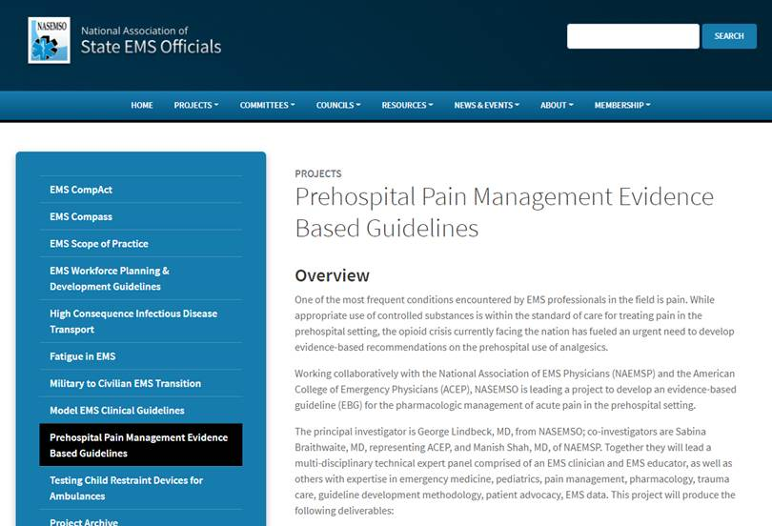
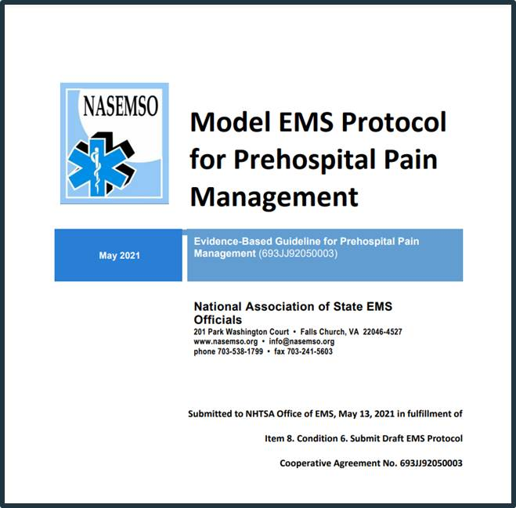
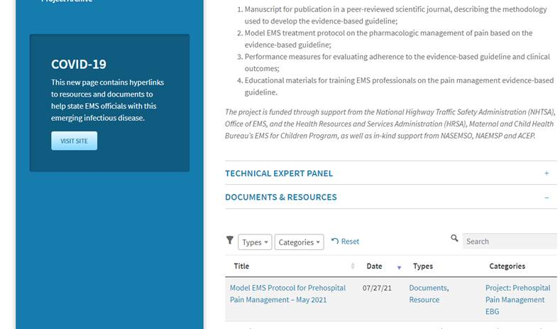
Posted on the project website at https://nasemso.org/wp-content/uploads/PainMngmntEBG-ModelProtocol_Final_5-31-21.pdf
© National Association of State EMS Officials (NASEMSO). All rights reserved

Slide 56
Goal
Multimodal options are used by EMS to treat pain from various etiologies in a safe and effective way based on pain severity, patient history, hemodynamic status, & choice unless interventions are contraindicated or patient refuses
(Photo by Doug Pensinger/Getty Images)
© National Association of State EMS Officials (NASEMSO). All rights reserved.

Slide 57
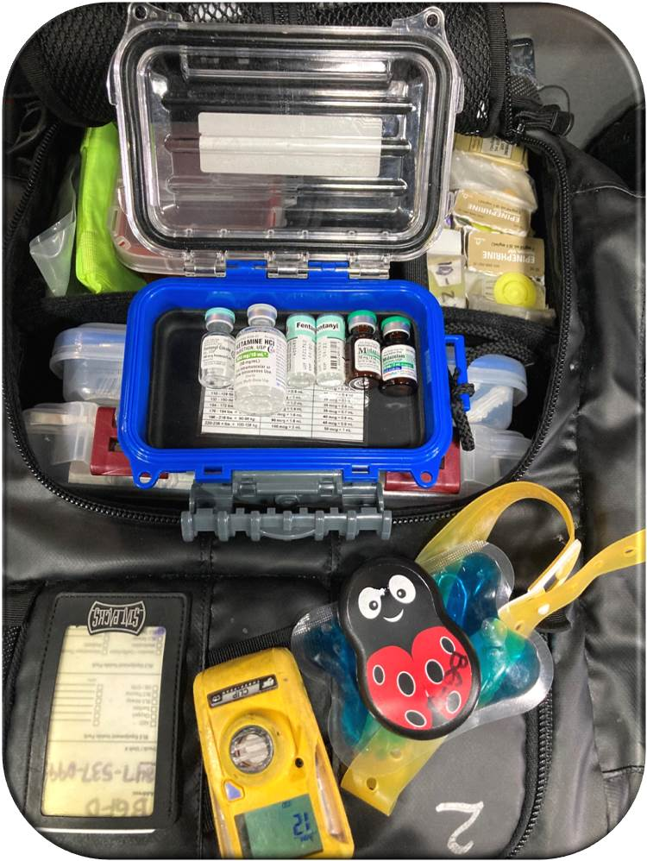
What’s in your toolbox now?
What could or should be?
Elephant Elite EL1907t
© National Association of State EMS Officials (NASEMSO). All rights reserved

Slide 58
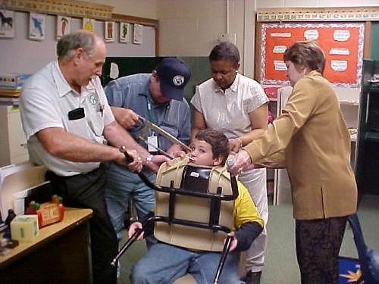
Pediatric Pain Assessment
How did this happen?
Lorin R. Browne, DO, FAAP
Associate Professor of Pediatrics and Emergency Medicine
Medical College of Wisconsin
Associate Medical Director, Pediatrics
Milwaukee County Office of Emergency Management EMS
https://www.myconfinedspace.com/
© National Association of State EMS Officials (NASEMSO). All rights reserved
Notes:
As a board certified pediatric emergency medicine specialist, Dr. Browne is invested in improving the emergency medical care of children through quality clinical research focused on prehospital pediatric care and competent education of emergency medicine providers. Dr. Browne is focused on high-quality, priority-based research to improve the care delivered to children prior to hospital arrival.

Slide 59
Myths about pain in children
Infants can’t feel pain
Children experience less pain than adults
Children will admit to pain
Children recover more quickly from pain
Opiates always cause respiratory depression in children
https://www.apa.org/monitor/2021/07/ce-corner-developmental-trauma
Notes:
Generally speaking, any injury or condition that would cause severe pain in an adult will also cause severe pain in a child, even if they are unable to communicate that perception.

Slide 60
Assessment: Pain by the numbers
10
9
8
7
6
5
4
3
2
1
0
Photo by Matt Duncan on Unsplash
Notes:
Due to its subjective nature, EMS personnel must start with the assumption that pain is “Whatever the experiencing person says it is, existing where and when they say it does, and is the stated level of severity.” How pain is perceived or tolerated is impacted by clinical, cultural and/or personal factors and is not limited by age, economic class, ethnic group, or social status.

Slide 61
Pain assessment in children
Requires careful observation of key behaviors appropriate for their age & development
https://www.romper.com/

Slide 62
Revised FLACC Scale: Birth to 7 yrs or unable to communicate their pain Scores range: 0–10 (0 = no pain)
Categories | 0 | 1 | 2
Face | No particular expression or smile | Occasional grimace or frown; withdrawn, disinterested. Sad, appears worried. | Frequent to constant quivering chin, clenched jaw; disinterested looking face; expression of fright or panic.
Legs | Normal position or relaxed; usual tone an motion to limbs | Uneasy, restless, tense; occasional tremors | Kicking or legs drawn up; marked increase in spasticity; constant tremors/jerking
Activity | Lying quietly, normal position, moves easily; reg. rhythmic respirations | Squirming, shifting back & forth, tense; guarded movements, mildly agitated; shallow, splinting respirations, intermittent sighs | Ached, rigid, or jerking; severe agitation, head banging; shivering, breath holding, gasping, severe splinting
Cry | No cry (awake or asleep) | Moans or whispers, occasional complaint; occasional verbal outbursts, constant grunting | Crying steadily, screams or sobs, frequent complaints; repeated outbursts, constant grunting
Consolability | Content, relaxed | Reassured by occasional touching, hugging or being talked to, distractible | Difficult to console or comfort; pushing caregiver away, resisting care or comfort measures
(Malviya, S. et al, 2006)
Notes:
The pain scales presented are only some of the many options available. Participants are encouraged to look to the literature to determine those that work best for EMS. Pain scales typically assess patients with all types of pain but may not be fully accurate in those with severe chronic or breakthrough pain (cancer or severe inflammatory reaction-related), those who are non-verbal, or do not perceive pain in usual ways. Patients with autism spectrum disorder may have a heightened or reduced sensitivity to pain or experience it in unusual ways. They may not be able to express their distress due to communication and social difficulties.
Most scales try to assess pain severity or intensity and are modified for adults, children, the elderly, those with dementia, or those who have language fluency challenges. In patients with chronic pain, determine their baseline and where they rate the pain now in comparison.
Options: Verbal Rating Scales (VRS); Visual Analogue Scales (VAS), and Numerical Rating Scales (NTS). The Wong-Baker Faces scale and Faces Pain Scale-Revised (FPS-R) and observational-behavioral scales are also helpful tools.
Malviya, S., Vopel-Lewis, T., Burke, C., Merkel, S., Tait, A.R. (2006). The revised FLACC observational pain tool: improved reliability and validity for pain assessment in children with cognitive impairment. Pediatric Anesthesia, 16(3), 258-265. (Red font indicates the newer additions)

Slide 63
Children’s Hospital of Eastern Ontario Pain Scale (CHEOPS)
Variables | Score 0 | Score 1 | Score 2
Cry | No | Crying, moaning | Scream
Facial | Smile | Neutral | Grimace
Verbal | Positive statement | Negative statement | Suffering from pain
Torso | Neutral | Variable, upright | Stretched
Legs | Neutral | Cont. moving, kicking | Stretched
© National Association of State EMS Officials (NASEMSO). All rights reserved.

Slide 64
Children 4-12 years of age
Faces Scales
https://www.disabled-world.com/health/pain/scale.php
© National Association of State EMS Officials (NASEMSO). All rights reserved.

Slide 65
Combination tool
Combination tool

Slide 66
https://www.allinahealth.org
© National Association of State EMS Officials (NASEMSO). All rights reserved..

Slide 67
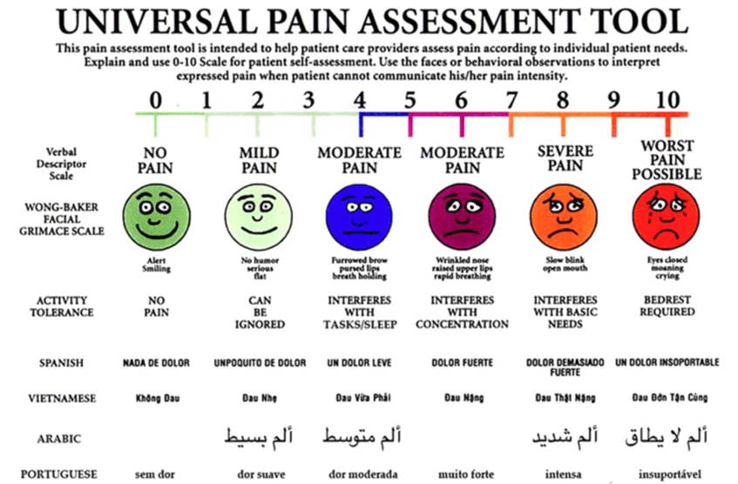
© National Association of State EMS Officials (NASEMSO). All rights reserved..
Notes:
It is helpful to have multiple languages on the pain assessment tool for those that can read descriptors in their primary or preferred language. Whatever scoring System is used, stay consistent with that tool. While not absolutely accurate, they do provide a basis for trending and ongoing monitoring. We would hope for an improvement of 20-25% after EMS comfort/analgesia interventions if possible.

Slide 68
Not all pain scores appear accurate
4??
10??
4??
Notes:
Context can influence pain perception: How a patient perceives and rates their pain can be influenced by age, gender, condition, culture, social/emotional factors, environment, motivation to over or under estimate pain; meaning ascribed to pain, level of anxiety, fatigue, previous experience with pain, and support system.
Symptom amplification: Consider that some complaints may be amplified or minimized by a patient. Obtain as much information as possible about previous injury/illness and what was done to diagnose or treat them at that time. Some patients have hypochondriacal preoccupations or may fear aging and death. Exaggeration of S&S may also stem from environmental factors traced to childhood experiences.
Factitious disorders: Some deliberately fake illness as they have a wish to gain attention or be treated as if they are ill. Some have a Cluster B disorder, substance use, or a mood disorder.
Malingering: Feigned S&S may be motivated by a desire to avoid life situations (military duty, work, school, criminal prosecution) or to gain financially, or seek drugs. Both malingering and factitious disorders involve the active use of conscious deceit to obtain personal ends. In some instances the symptoms are consciously produced and in others they are unconsciously caused. There is a continuum between exaggeration (amplification) and malingering.

Slide 69
What else should EMS assess?
www.marca.com/en/football/barcelona/2018.html
© National Association of State EMS Officials (NASEMSO). All rights reserved..
Notes:
Look for physiologic and behavioral cues as to pain severity. Vital signs (patient may be in severe pain and not have grossly altered VS); skin exam (look for analgesic patches, evidence of inflammation, injury, or hypoperfusion); and patient’s facial expression, sweat patterns, body language, position, movement, and the ability to talk.

Slide 70
Pain assessment tool in patient with dementia
www.jems.com/
© National Association of State EMS Officials (NASEMSO). All rights reserved..
Notes:
May need to have a surrogate of a non-verbal person provide information on behavior or activity changes that may suggest that they are in pain. The surrogates should be a reliable historian such as a caregiver or loved one that knows their baseline well.

Slide 71
Shared decision-making and patient preferences
https://www.amsjournal.com/
Eddy S. Lang, MDCM, CCFP (EM), CSPQ
University of Calgary
Alberta Health Services
https://www.ems1.com/pain-management/
© National Association of State EMS Officials (NASEMSO). All rights reserved..
Notes:
Dr. Lang is a Professor and Department Head for Emergency Medicine at Cumming School of Medicine- University of Calgary and Alberta Health Services, Calgary Zone. He is a member of the GRADE working group and has led the development of GRADE-based clinical practice guidelines in pre-hospital care in the US as well as with the International Liaison Committee for Resuscitation.
First acknowledge that there are interventions provided by EMS that CAUSE pain: Palpation during an exam, splinting/immobilization; vascular access; blood glucose reading; undressing patients; eye irrigation; pacing/cardioversion; and wound care. Warn patients in advance; use a gentle touch, and offer proactive choices when appropriate.

Slide 72
What is a person-centered approach to pain mgt?
Photo: Adam Mason (JEMS)
© National Association of State EMS Officials (NASEMSO). All rights reserved.
Notes:
Advocate for active involvement of the patient in decisions about their treatment. The Institute of Medicine (IOM) defines patient-centered care as providing care that is respectful of and responsive to individual patient preferences, needs, and values, and ensuring that patient wishes guide all clinical decisions.
Pain management strategies should consider the patient's current presentation and wishes, the health care providers' clinical judgment, and the risks and benefits associated with intervention options, including the potential risk of dependency, addiction, and abuse.

Slide 73
Patient choice
is important!
What else should be considered?
Underlying pathology, pain intensity, scope of practice
© National Association of State EMS Officials (NASEMSO). All rights reserved..
Notes:
Consider patient factors: genetics, culture, age, previous pain experiences, comorbidities; plus responder scope of practice, and risks/benefits of each strategy.
Establish realistic pain goals. Provide individualized pain mgt. tailored to patient needs regardless of transport interval

Slide 74
Obtaining Past Medical History is Critical
www.verywellhealth.com/rheumatoid-arthritis-pain-medications-5113504
© National Association of State EMS Officials (NASEMSO). All rights reserved.
Notes:
Get as much information as possible about causes and nature of the pain now compared to baseline or similar past episodes.
Pain is generally caused by:
-Inflammation, swelling, distention, or dilation
-Low blood flow to a tissue /organ d/t obstruction/ perfusion restriction
-Excessive stimulation of a sensory organ
-External pressure on a nerve or nerve damage
-Exceeding thresholds of cold, heat, pressure
-Extended contraction of a muscle; muscle spasm
History all current meds – especially those for pain (NSAIDs, opioids, over the counter, herbal or homeopathic approaches); any meds or substances that could potentiate or alter EMS interventions (sedatives, or CNS depressants); time and amount of last dose. What has worked or not worked in the past? Any known allergies/adverse reactions to pain meds?

Slide 75
When you touch someone with intention, you are saying, I am here to help you heal. Inspirebywhitney.com
Creator: gorodenkoff Credit: Getty Images
© National Association of State EMS Officials (NASEMSO). All rights reserved.
Notes:
Empathy and caring go a long way to relieving patient distress. A pat on shoulder, forearm, or hand may bring comfort to those in distress.
Be alert to non-verbal cues and patient wishes or sensitivity to being touched. Gain their consent for therapeutic touch.

Slide 76
What can help alleviate pain other than medications?
Empathy, verbal engagement
Use repositioning, breathing; heat/cold; splints; guided imagery
Cure sometimes. Treat often. Comfort always.
Hippocrates
John Moore/Getty Images-
© National Association of State EMS Officials (NASEMSO). All rights reserved.
Notes:
There are at least 10 factors that lead to pain complaints in the absence of a medical diagnosis. These should also be considered by EMS.
Psychiatric Times, October 2020
Somatoform pain: Pain persists past the point of adaptive reaction to injury. Patients may have feelings of isolation, worthlessness and depression. High health anxiety; long-standing or more severe pain; reduced capacity to cope with stress; lower pain threshold; perhaps a more sensitive autonomic nervous system (ANS); greater sympathetic activation.
Psychiatric illness: Chronic pain may lead to depression and anxiety; mood changes are a reaction to an alteration in function; altered life choices can occur due to dysfunctional coping strategies; chronic pain becomes associated with reduced activity which reinforces pain and adds to health hazards such as obesity; psychiatric disorders lone render one more prone to chronic pain
Psychosocial factors: Stress increases the perception of pain. Pain intensity may be higher in those with recent adverse life events who have lower socio-economic status, poor education and limited ability to explain symptoms putting them at a psychosocial disadvantage.
Patients in pain want to be heard – and for caregivers to acknowledge their distress; and provide options for mitigating their suffering. Verbal engagement may be good distraction for them. Allow them to assume a position of comfort if possible. Splinting musculoskeletal injuries reduces movement and may reduce muscle spasm, thus impacting the pain-spasm cycle.
Do not elevate a pulseless extremity or apply a cold pack to a cold and/or cyanotic limb.

Slide 77
Non-pharmacologic Considerations in children
Use distraction (bubbles, Buzzy, music, electronics, toys)
Consider need for caregiver presence; holding, pacifier
www.evidentlycochrane.net/chronic-pain-children-drugs/
© National Association of State EMS Officials (NASEMSO). All rights reserved.
Notes:
Cognitive coping strategies
Children can close their eyes and picture a happy place, experience, or memory. Encourage them to tell you about a party, pet, favorite toy, game, or music they like; friends, family, or sport they play. Can use small toys, blown up gloves with faces on them, stress/squeeze balls, storytelling; games, electronic devices, keys, penlight, or stethoscope to distract them. Have a distraction toolkit!
Buzzy® Mini Healthcare is like a TENS unit. When placed over a cold pack, allows for pain-free injections or IV starts.
Approach: Calm, non-threatening manner. They often become very anxious when in pain. Speak to the child by name and in a steady gentle voice, on their level…kneel or sit during the interview.

Slide 78
Considerations in Pharmacologic pain treatment options
Options presented are not carried by all EMS agencies and do not replace protocols approved by your EMS Medical Director
Sabina Braithwaite, MD, MPH
Associate Professor of Emergency Medicine and EMS Fellowship Director Washington University in St Louis
https://www.ismp.org/resources
© National Association of State EMS Officials (NASEMSO). All rights reserved.
Notes:
Dr. Braithwaite has extensive experience as an EMS medical director and in EMS education at all levels. She has been active in leadership of several national organizations and projects, including the NAEMSP, ACEP, International Trauma Life Support and the EMS Culture of Safety Strategy Project. In particular, she was one of the key participants in the development of the original NASEMSO National Model EMS Clinical Guidelines Project. Sabina is board certified in Emergency Medicine and is subspecialty certified in Emergency Medical Services. She also holds an MPH with a specialty certificate in Disaster Management.

Slide 80
“Rights” of medication administration
RIGHT
Patient: Denies allergy
Drug: Independent cross-check
Dose
Route & site
Timing of administration
Reason: Indicated/not contraindicated
Documentation
© National Association of State EMS Officials (NASEMSO). All rights reserved.
Notes:
First, let’s get it “Right”. Check package/ container for drug name, amount, concentration, integrity, and expiration date. Inspect the packaging for intact seals and no signs of tampering. Check the drug solution for discoloration, cloudiness or precipitation. Verify sterility of parenteral meds. Prepare accurate dose based on patient age, size, condition and protocols. Controlled substances and high risk meds (peds dosing/others per protocol) require a cross check with another qualified practitioner per local protocols.

Slide 81
If non-pharmacologic interventions are insufficient - Consider use of pharmacologic analgesics
PO options for milder pain – onset of action slower; desire to avoid parenteral meds or opioids
Acetaminophen 15 mg/kg PO (max dose 1 gram)
Ibuprofen 10 mg/kg PO if older than 6 months (max dose 800 mg)
https://www.aarp.org/
© National Association of State EMS Officials (NASEMSO). All rights reserved.
Notes:
Contraindications to oral NSAIDs:
-Inability to swallow or take medications by mouth
-Respiratory distress with possible aspiration syndrome
-Persistent vomiting
-Allergy to NSAIDs
-History of peptic ulcer disease or GI bleeding; renal failure, liver disease, younger than 6 months without OLMC order
Use with caution in elderly patients; determine if they are on blood thinners or already take NSAIDs

Slide 82
Why is pain management a challenge in children?
Needle phobia!
Strongly consider intranasal options
Photo by: REUTERS/Lindsey Wasson
© National Association of State EMS Officials (NASEMSO). All rights reserved.
Notes:
Difficulties stemming from the child's age and developmental level, ability to self-report, relying on behavioral and physiological indicators of pain, and selecting the appropriate pain assessment scale. Add to that the alterations in the pharmacokinetics and pharmacodynamics of medications used for pain management in children; a child’s fear of needles, the difficulty in placing IV catheters, and the influence of parents/care givers.

Slide 83
Intranasal route (IN) using the Mucosal Atomizer Device (MAD)
Preferred for initial dosing (for pain) if no IV access
FENTANYL 1 mcg/kg IN
KETAMINE 0.5 mg/kg IN (max initial dose 25 mg; max cumulative dose 100 mg)
Photo/Jon Lee)
© National Association of State EMS Officials (NASEMSO). All rights reserved.
Notes:
These are suggested doses based on literature and guidelines. The TEP recognizes and supports the authority of each EMS Medical Director to determine their local protocols and drug dosing based on their discretion, medical opinion, state, and local factors.

Slide 84
Intramuscular (IM) options ☹
KETOROLAC (one-time dose only)
Adult (non-pregnant): 30 mg IM
Pediatric (2-14 years old): 1 mg/kg IM
(max dose 30 mg)
MORPHINE sulfate: 0.1 mg/kg IM
(max initial dose 15 mg)
FENTANYL 1 mcg/kg (max initial dose 100 mcg)
KETAMINE 0.3 mg/kg IM
(max initial dose 25 mg)
https://epmonthly.com/article/the-right-route/
© National Association of State EMS Officials (NASEMSO). All rights reserved.
Notes:
These are suggested doses based on literature and guidelines. The TEP recognizes and supports the authority of each EMS Medical Director to determine their local protocols and drug dosing based on their discretion, medical opinion, state, and local factors.

Slide 85
Inhaled nitrous oxide (N₂O) if available
https://www.hmpgloballearningnetwork.com
© National Association of State EMS Officials (NASEMSO). All rights reserved.
Notes:
NAEMSP published a position paper on EMS use of nitrous oxide in 1990.
Nitrous oxide is a CNS depressant. It dulls the senses, blunts perception of painful stimuli, and produces a carefree attitude.
It also potentiates the release of endogenous endorphins that react with opioid receptors in the CNS to elevate the pain threshold & create a feeling of relaxation and euphoria.
Advantages: Little effect on CV system – mild vasodilation; no direct effect on skeletal muscle
Does not require an IV; Onset & duration: 2-5 minutes; metabolized & excreted in the lungs

Slide 86
IV Route
ACETAMINOPHEN
Adult: 1 g IV
Peds: 15 mg/kg IV (max dose 1 g)
KETOROLAC (one-time dose only)
Adult (non-pregnant): 15 mg IV
Peds (2-14 years old): 0.5 mg/kg IV (max dose 15 mg)
FENTANYL
Adult: 25-50 mcg IV
Peds: 1 mcg/kg; (max initial dose 50 mcg)
/www.allthingsfirstaid.com/statpacks_medical_trauma_packs.aspx
© National Association of State EMS Officials (NASEMSO). All rights reserved.
Notes:
These are suggested doses based on literature and guidelines. The TEP recognizes and supports the authority of each EMS Medical Director to determine their local protocols and drug dosing based on their discretion, medical opinion, state, and local factors.

Slide 87
IV ROUTE cont..
MORPHINE sulfate:
Adult: 5 mg IV
Peds: 0.1 mg/kg IV (max initial dose 5 mg)
HYDROMORPHONE
Adult: 1-2 mg IV
Peds: 0.015 mg/kg IV (max initial dose 2 mg)
KETAMINE
Adult: 25 mg slow IVP or infusion in 100 mL NS/LR
Peds: 0.25 mg/kg IV (max initial dose 25 mg)
(max cumulative dose 100 mg
© National Association of State EMS Officials (NASEMSO). All rights reserved.
Notes:
These are suggested doses based on literature and guidelines. The TEP recognizes and supports the authority of each EMS Medical Director to determine their local protocols and drug dosing based on their discretion, medical opinion, state, and local factors.

Slide 88
Anticipate Before Complications – have anti-emetic ready to treat nausea in high-risk patients
https://www.thesun.ie/news/
© National Association of State EMS Officials (NASEMSO). All rights reserved.
Notes:
Nausea is a well-documented side effect of opioid administration for acute pain. Anticipate this side effect and prepare ondansetron slow IVP or rapid oral dissolve tablet per local protocols.

Slide 89
Reassess q. 5 minutes! Repeat doses per protocol (if not contraindicated) until pain is tolerable, max dose is given, patient refuses, or SE evident
Careful/diligent ongoing reassessment
© National Association of State EMS Officials (NASEMSO). All rights reserved.
Notes:
Monitor for desired effects, but also for adverse reactions (AMS, hypotension, bradycardia, hypoventilation, hypoxia, hypercarbia, S&S of allergy or anaphylaxis). Should always have a full set of VS + oximetry readings (SpO₂ & ETCO₂) if a potential for respiratory depression + pain reassessment after all pain medication administration.

Slide 90
BRING IT ON HOME –
There’s no going back! Our course is set straight to the future using the evidence as our guide….
https://knowyourmeme.com/photos/1848694-back-to-the-future
© Naional Association of State EMS Officials (NASEMSO). All rights reserved.
Notes:
We never want to see 2020 again! (Nor go back to old ways of doing things that did not achieve EB care or optimal outcomes.)

Slide 91
What practice changes will you make moving forward?
© National Association of State EMS Officials (NASEMSO). All rights reserved.
Notes:
One definition of learning is “changed behavior”. What change in approach, policy, procedure or protocol do you anticipate making based on this new body of evidence?

Slide 92
Questions regarding this education module should be directed to:
NATIONAL ASSOCIATION OF STATE EMS OFFICIALS
201 Park Washington Court
Falls Church, VA 22046-4527
www.nasemso.org
info@nasemso.org
phone 703-538-1799
fax 703-241-5603
© National Association of State EMS Officials (NASEMSO). All rights reserved.
Notes:
If you have specific questions on the educational materials, please feel free to reach out to:
Connie J. Mattera, MS, RN, PM; cmattera@nch.org

