Slide 1
Ambulance Safety For Children
A Perspective and a Goal
NASEMSO
Safe Transport of Children Committee
Washington, DC
April 6, 2016
Marilyn J. Bull, MD, FAAP
Morris Green Professor of Pediatrics
Riley Hospital for Children at Indiana University Health
Indiana University School of Medicine
Automotive Safety Program
Section of Developmental Pediatrics
Indianapolis, IN

Slide 2
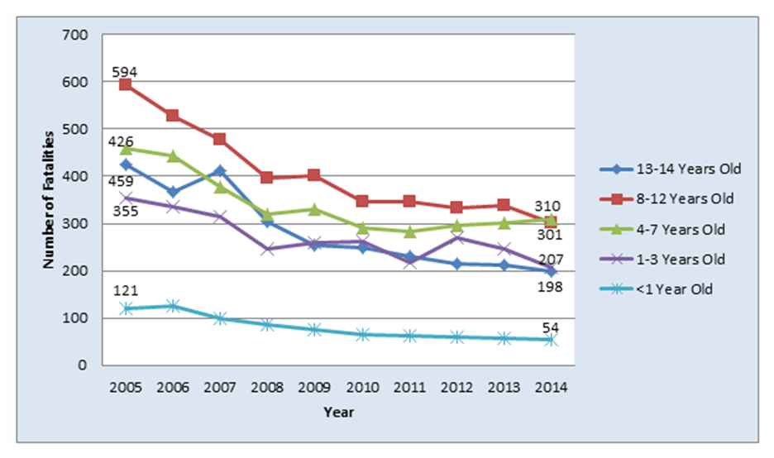
Child Occupant Protection
Great Measures of Success

Slide 3
Persistent Gaps in Child Occupant Protection
Child Passengers on Airplanes
School Bus Transportation
Safe Transportation for Children with Special Needs
Occupant Protection for Ambulance Passengers

Slide 4
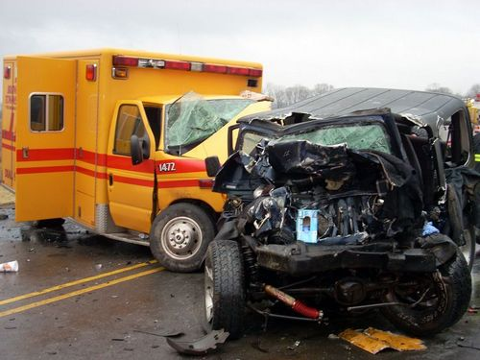
Occupant Protection for Ambulance Passengers
Front occupant protection
Rear compartment attendant protection
Rear compartment patient protection
Special considerations for child occupants

Slide 5
Incubator Video
AAAM, 1998

Slide 6
6 YO w/Cot Restraints

Slide 7
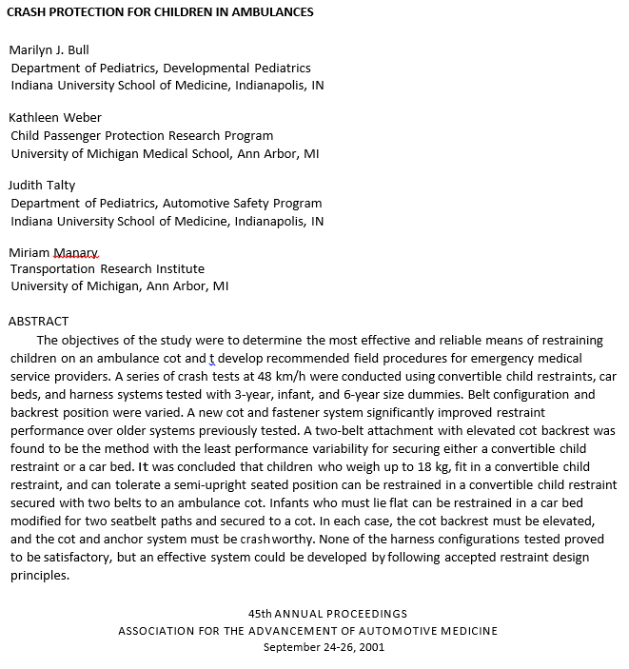

Slide 8
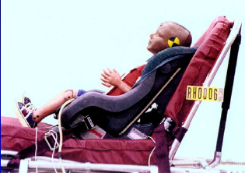
Convertible CSS: Cot Belt Through RF & FF Belt Path

Slide 9
Crash Test Video: Convertible

Slide 10
Test | Dummy Mass (kg) | Head Peak g | HIC | Chest Peak g | Chest g ≥3 ms | Max Angle
Cvt – A | 15 | 41 | 362 | 43 | 42 | 53°
Cvt – B₁ | 15 | 48 | 739 | 48 | 48 | 77°
Cvt – B₂ | 15 | 52 | 460 | 46 | 45 | 54°
Cvt – B₃ | 18 | 52 | 501 | 44 | 43 | 52°
FMVSS 213 | 15 | n/a | 1000 | n/a | 60 | 70°
Acceleration and maximum back-angel results for 3-year dummies in convertible child restraints secured facing rearward with two belts on an ambulance cot, with FMVSS 213 criteria
AAAM, 2001

Slide 11
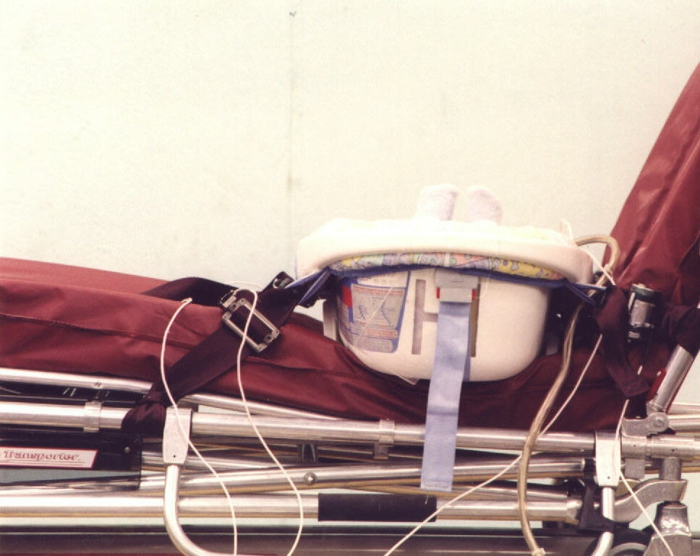
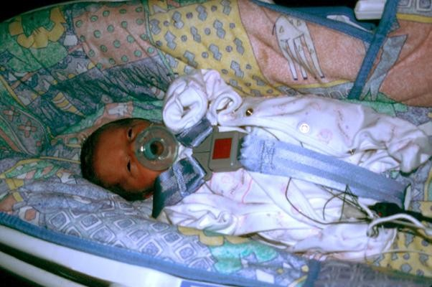
Dream Ride Car Bed

Slide 12
Crash Test Video: Car Bed

Slide 13
Test | Dummy Mass (kg) | Head Peak g | HIC 22 ms | Chest Peak g | Chest g ≥3 ms
CB – A₁ | 8 | 72 | 520 | 68 | 65
CB – A₂ | 8 | 52 | 405 | 63 | 55
Melvin, 1995 | 8 | 50 | 390 | 50 | n/a
Acceleration results for 6-month dummies in car beds secured laterally with two belts on an ambulance cot, with Melvin [1995] criteria.
AAAM, 2001

Slide 14
6 months
61 cm.
7.3 kg.

Slide 15
6 months
61 cm.
7.3 kg.

Slide 16
2 years
90 cm.
13.8 kg.

Slide 17
2 ½ years
98 cm.
15.5 kg.

Slide 18
5 years
96.6 cm.
16 kg.

Slide 19
7 years
115.5 cm.
23.4 kg.

Slide 20
10 years
134.6 cm.
32 kg.

Slide 21
This seat will be rear facing in the vehicle. In this picture, the seat is not tight enough.

Slide 23
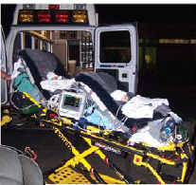

Slide 24
http://search.usa.gov/search?utf8=%E2%9C%93&affiliate=dot-nhtsa&query=ems+ambulance+working+group

Slide 25
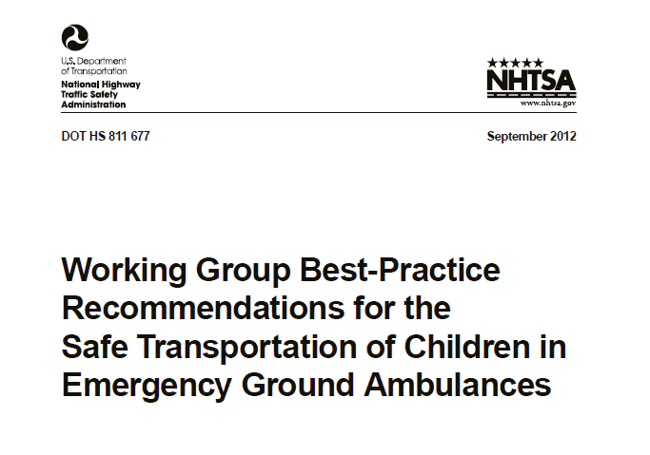
Five Situations were Identified as Most Frequently Faced by EMS Providers & Interfacility Transport Teams
Recommendations:
For a child who is uninjured/not ill
For a child who is ill and/or injured and whose condition does not require continuous and/or intensive medical monitoring and/or interventions
For a child whose condition requires continuous and/or intensive medical monitoring and/or interventions
For a child whose condition requires spinal immobilization and/or lying flat
For a child or children who require transport as part of a multiple patient transport (newborn with mother, multiple children, etc.)
Notes:
Straight from the Recommendations – Note Idaho has created a brochure that includes these five situations in one page handout!
See slide at the end

Slide 26
Improving Occupant Protection for Non-Critical Pediatric Patients in Ambulances: A Training Curriculum for EMS Personnel
EMS Training
NHTSA, NCS, Riley Hospital

Slide 27
EMS Improving Occupant Protection for Non-critical Patients in Ambulances
Module to train EMS providers on child restraints for ambulance use
Instructed by CPST with EMS certification
Length-4 hours
Available at www.preventinjury.org or 1 800 KID N Car

Slide 28
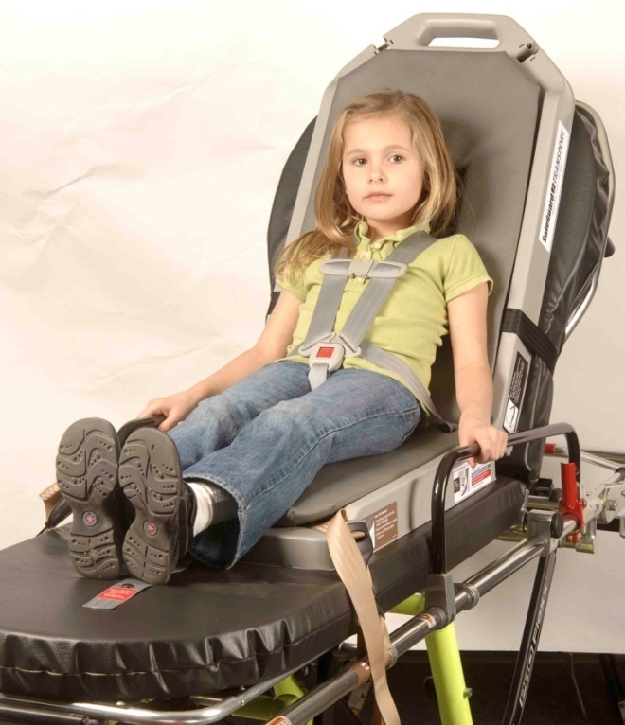
Safe Guard Transport by IMMI
Cot-mounted restraint for patients over 1 year of age from 22 to 100 lbs
Color-coded installation system for ease of use
Restraint weighs 22 pounds
5-point harness system with one-handed adjustment for harness height and tightness
Notes:
SafeGuard collaborated with Riley Hospital to develop a new pediatric transport solution which incorporates all of these design recommendations.
The new solution is the first cot-mounted restraint designed to transport pediatric patients of a wide range of sizes from 22 to 100 pounds.

Slide 29
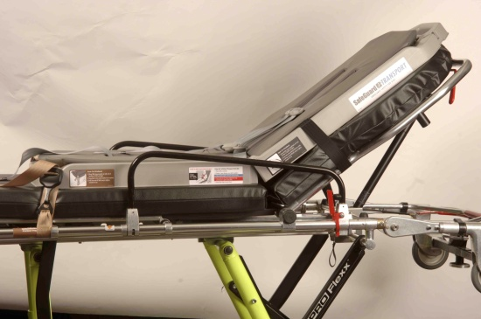
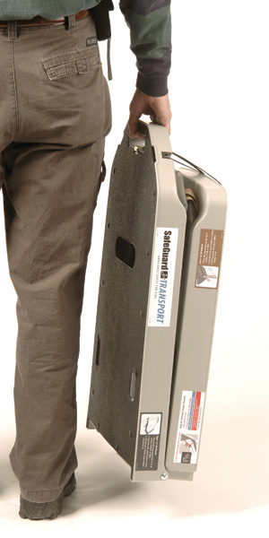
Safe Guard Transport by IMMI
Children 22-40 pounds can use with cot back angle at 70 and 45 degrees
Children 40-100 pounds can use with cot back angle at 70 degrees and completely flat
Not intended for use with potential spinal cord injuries
Crash test footage available on website www.IMMInet.com 317-896-9531
Notes:
First, let’s get a basic understanding how the restraint works:
Color-coded webbing attaches the restraint to the cot
A complete 5-point harness with automatic height adjustment secures the child
And, a wipe-clean foam pad & replaceable webbing facilitate care & cleaning
It is important to note this restraint is NOT intended for use with potential spinal cord injuries.
Next, a brief video will demonstrate installation and use of the restraint.
[Video will play AUTOMATICALLY – no need to click]

Slide 30
Ambulance-specific child restraint accommodating children 10-40 pounds
AAP PEPP, 2016

Slide 31
Pedi-Mate by Ferno
For infants and toddlers 10-40 pounds
For use on specific Ferno ambulance cots
3 straps attach to cot
5-point harness system
Made of lightweight vinyl, rolls up for storage
Contact manufacturer for crash test information 1-877-733-0911
www.ferno.com

Slide 32
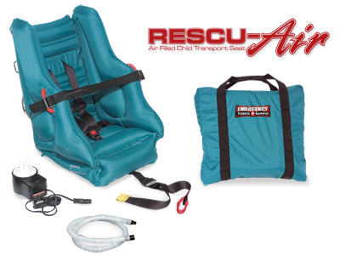
EP-96 The Rescu-Air: Air Filled Child Transport Seat
For children 20-40 pounds and less than 40” tall
Stores in 21” x 14” x 6” padded carrying case
Weighs 12 pounds
Must purchase “cot harness system” separately to use on ambulance cot
Notes:
Instructions for the “cot harness system” may not be included with straps.

Slide 33
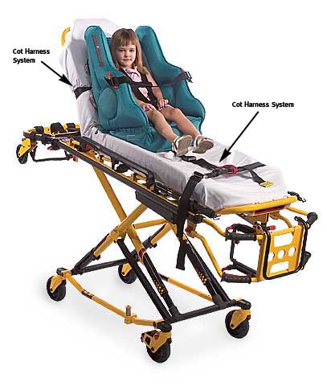
EP-96 The Rescu-Air: Air Filled Child Transport Seat
Five-point restraint system with pelvic adjustment
2-level adjustable shoulder harness
Inflates/deflates with included 12v DC pump in 60 seconds
Cot installation system sold separately
According to manufacturer meets FMVSS213
Contact manufacturer for crash test information
1-800-322-5725
www.epandr.com

Slide 34
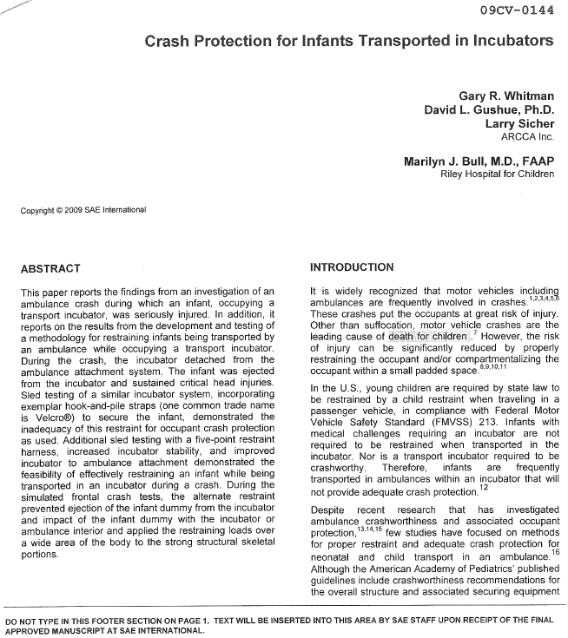

Slide 35
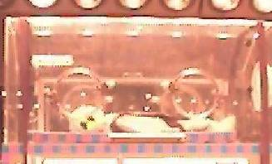
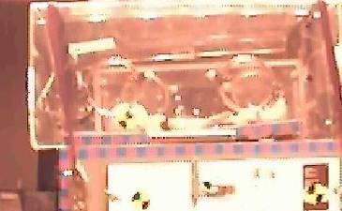
Simulated Crash Tests of Alternative 5-point Restraint (Infant’s head toward front)
FMVSS 213 crash
pulse: 48 kph (30 mph)
24 G
Civil Aerospace Medical
Institute (CAMI)
newborn infant dummy
(3.38 kg, 52 cm)
Pretest | Incubator cover begins to detach | Maximum dummy displacement
SAE 2009-01-2832

Slide 38
Kangoofix System
“Certified CEN 1789, 2007-a2010 compliant”
Ferno Norden

Slide 40
Istanbul, Turkey

Slide 41
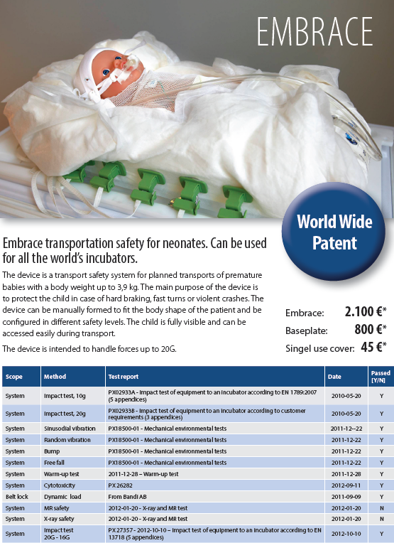
Embrace for Neonates

Slide 42
Proposed Goals Safe Transport of Children Committee (NASEMSO)
To recommend the criteria or specifications for proper restraint of children in ambulances. Such criteria will be evidence-based and will consider safety of both patients and providers.
To have the recommended criteria adopted by one or more accredited standard setting organizations.
To develop a strategy and resources for educating EMS providers on safely transporting children in ground ambulances based on the recommended criteria or standards.

Slide 44
Kangoofix In Use Video

Slide 45
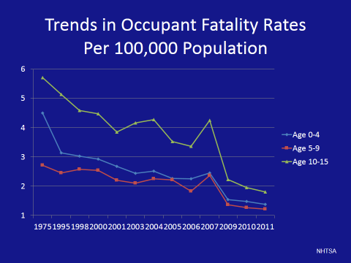

Slide 46
Combined, side impact injuries occurred in 14.6/1000 children and 26.8% of crashes. According to PCPS: Children in belt positioning boosters were at a 58% reduction in risk of injury than those in seat belts in side impact crashes.
Partners for Child Passenger Safety • www.chop.edu/service/car-seat-safety-for-kids/index.html
Annual Proceedings of the Association for the Advancement of Automotive Medicine, 2005.

